Slide 1
Lead Scoring Case Study Prepared by : Chand Pasha and Nithish
Problem Statement : An education company named X Education sells online courses to industry professionals. On any given day, many professionals who are interested in the courses land on their website and browse for courses. The company markets its courses on several websites and search engines like Google. Once these people land on the website, they might browse the courses or fill up a form for the course or watch some videos. When these people fill up a form providing their email address or phone number, they are classified to be a lead. Moreover, the company also gets leads through past referrals. Once these leads are acquired, employees from the sales team start making calls, writing emails, etc. Through this process, some of the leads get converted while most do not. The typical lead conversion rate at X education is around 30%. There are a lot of leads generated in the initial stage (top) but only a few of them come out as paying customers from the bottom. In the middle stage, you need to nurture the potential leads well (i.e. educating the leads about the product, constantly communicating etc. ) in order to get a higher lead conversion. X Education has appointed you to help them select the most promising leads, i.e. the leads that are most likely to convert into paying customers. The company requires you to build a model wherein you need to assign a lead score to each of the leads such that the customers with higher lead score have a higher conversion chance and the customers with lower lead score have a lower conversion chance. The CEO, in particular, has given a ballpark of the target lead conversion rate to be around 80%.

Slide 2
Our Goals of the Case Study:
To build a logistic regression model to assign a lead score between 0 and 100 to each of the leads which can be used by the company to target potential leads.
To adjust to if the company's requirement changes in the future so you will need to handle these as well.
The steps are broadly:
Read and understand the data
Clean the data
Prepare the data for Model Building
Model Building
Model Evaluation
Making Predictions on the Test Set

Slide 3
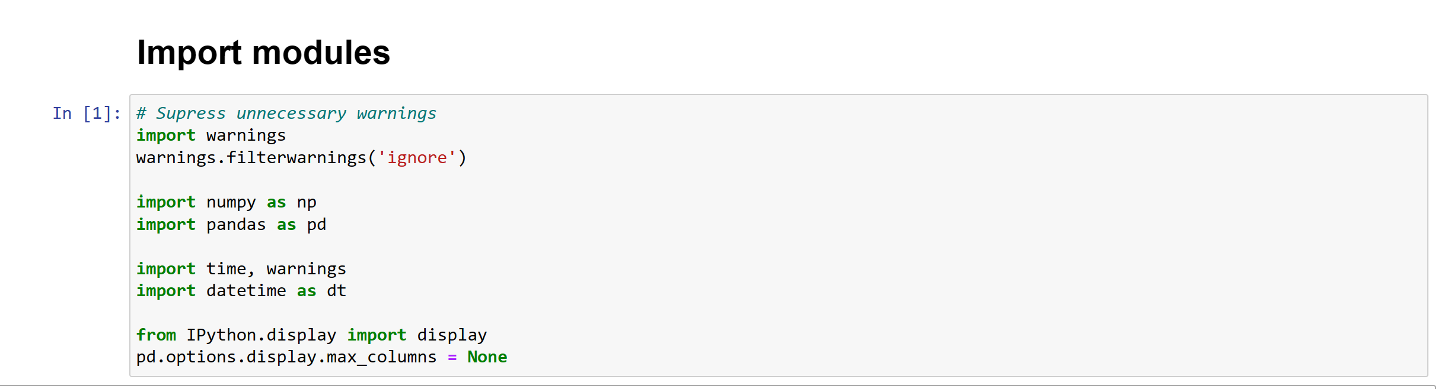
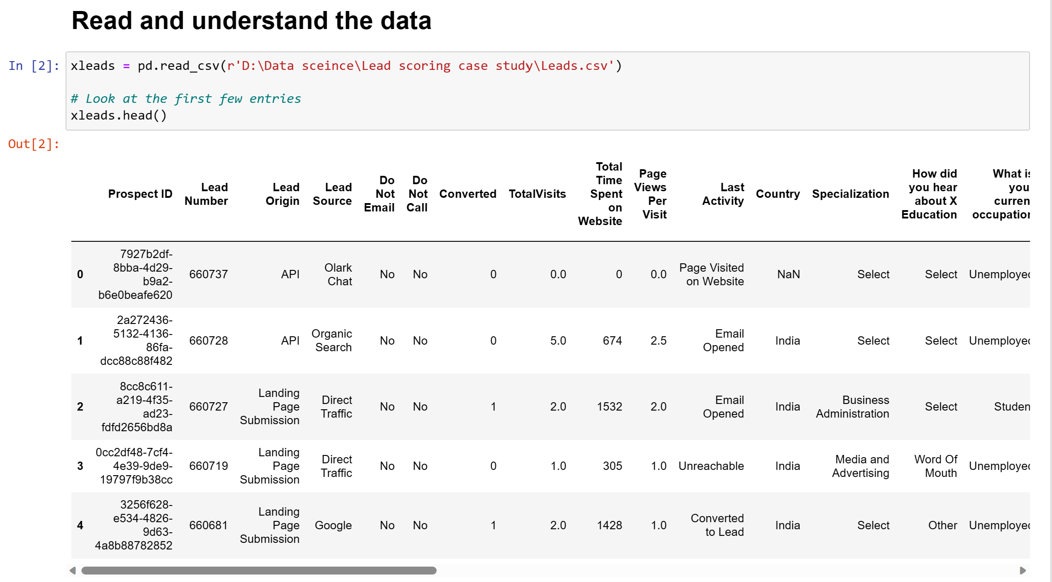

Slide 4
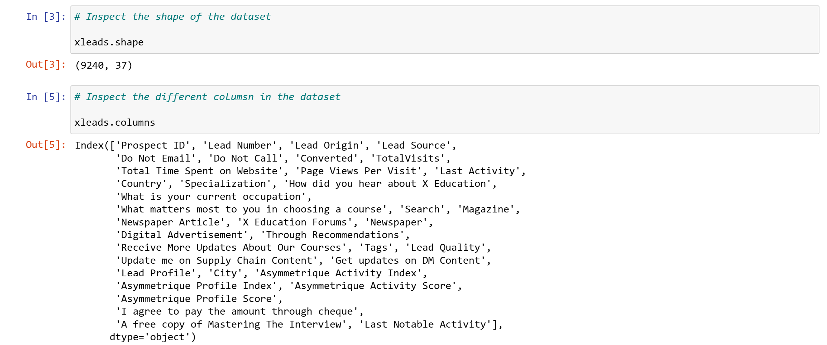
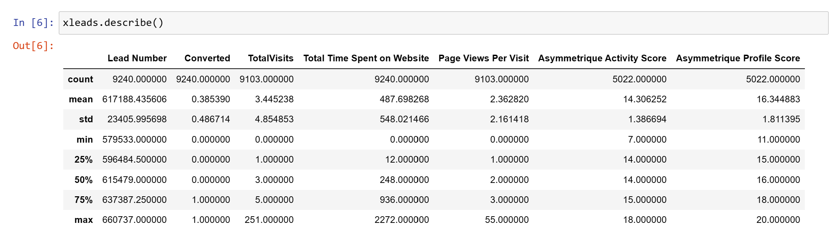

Slide 5
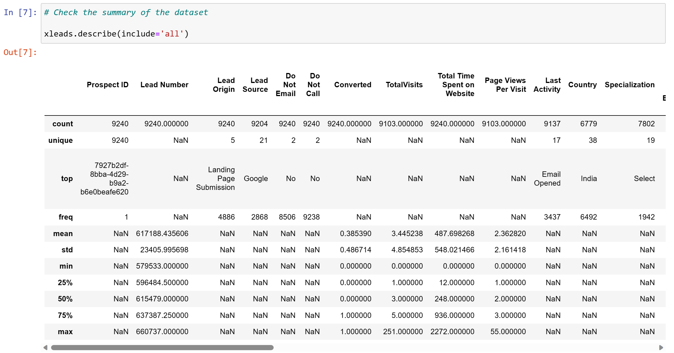

Slide 6
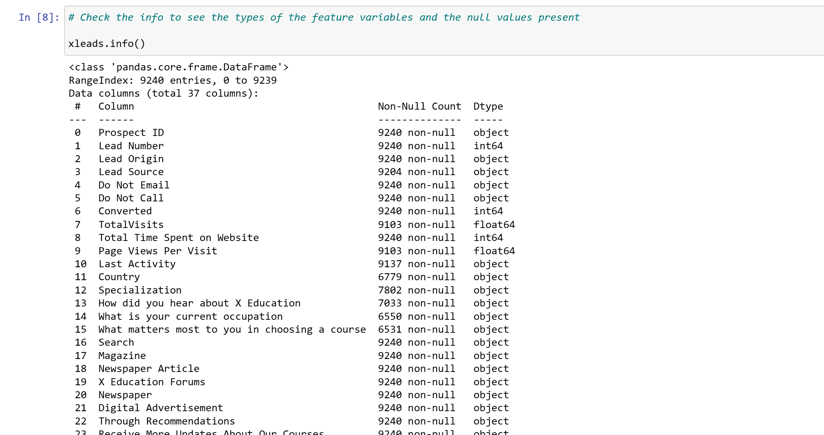

Slide 7
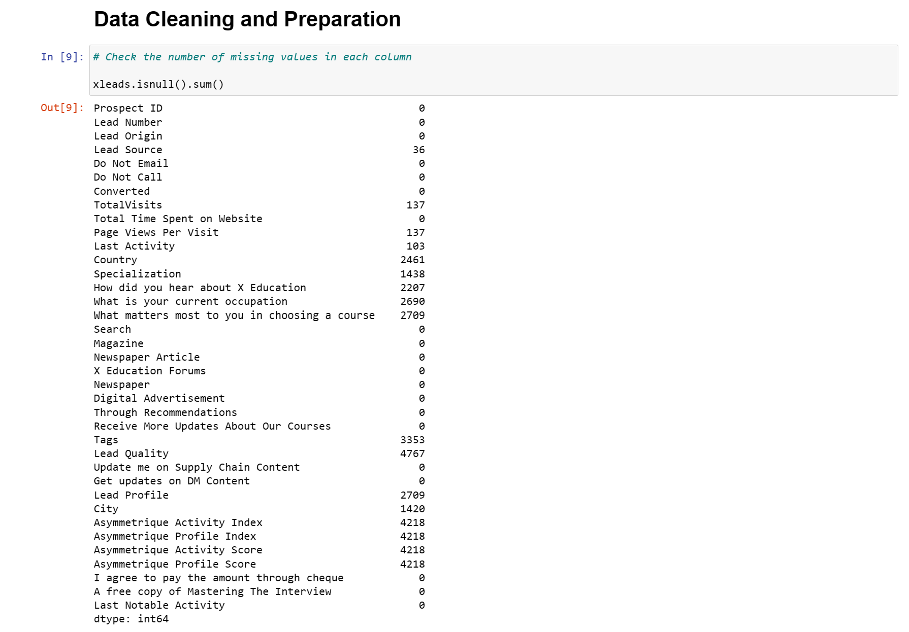

Slide 8
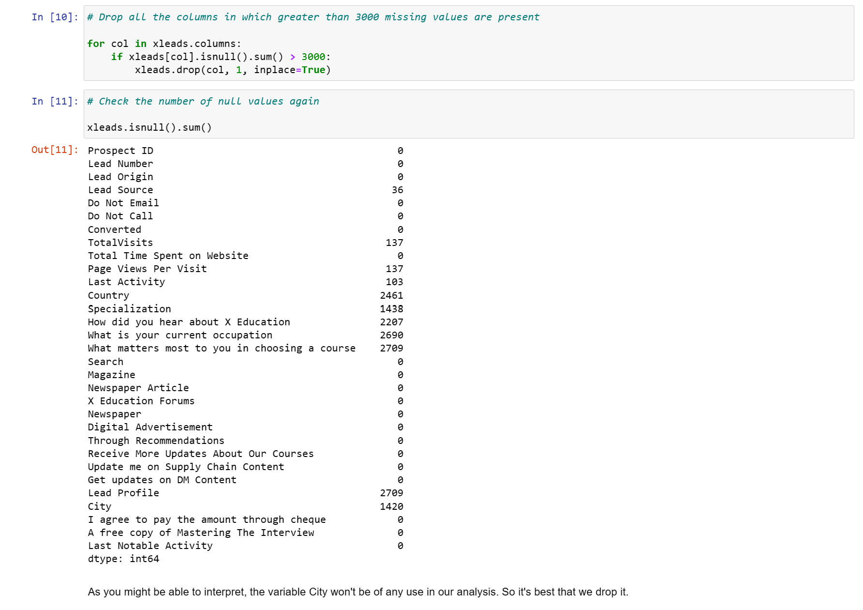

Slide 9
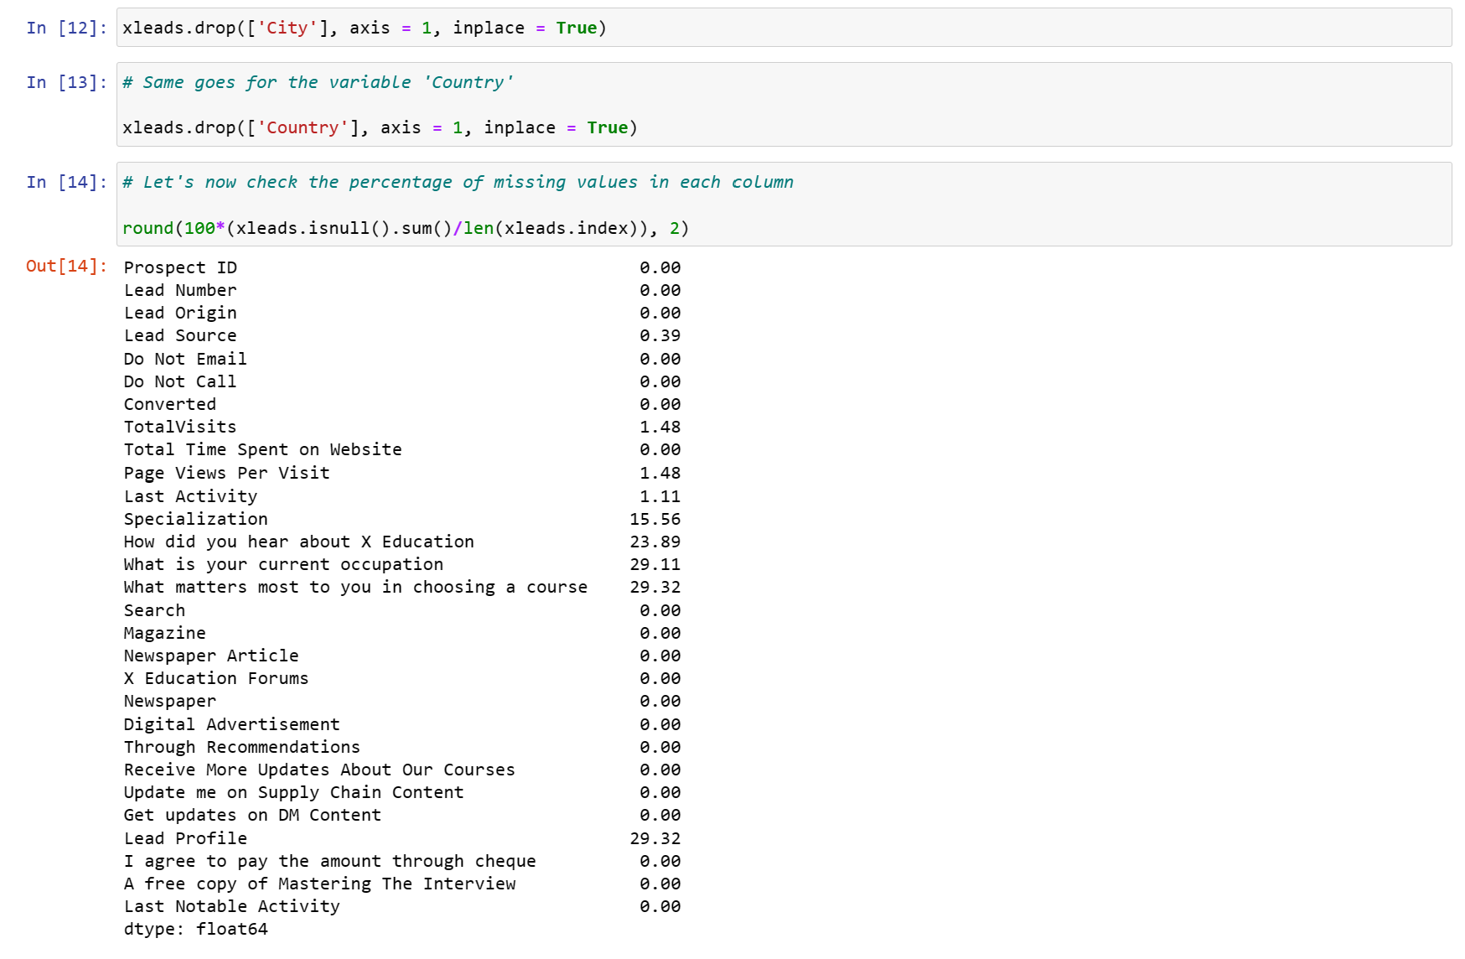

Slide 10
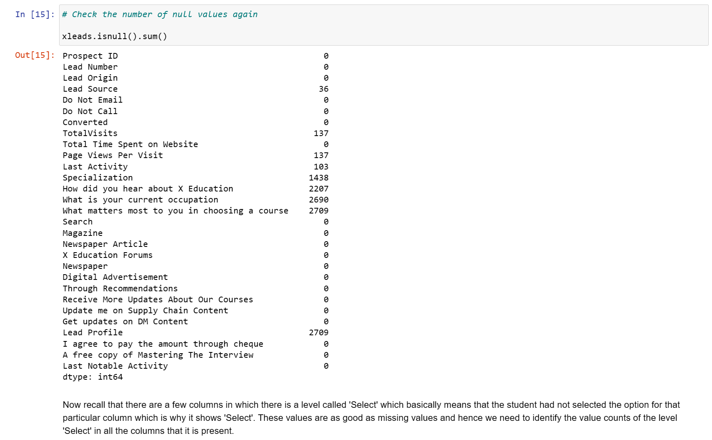

Slide 11
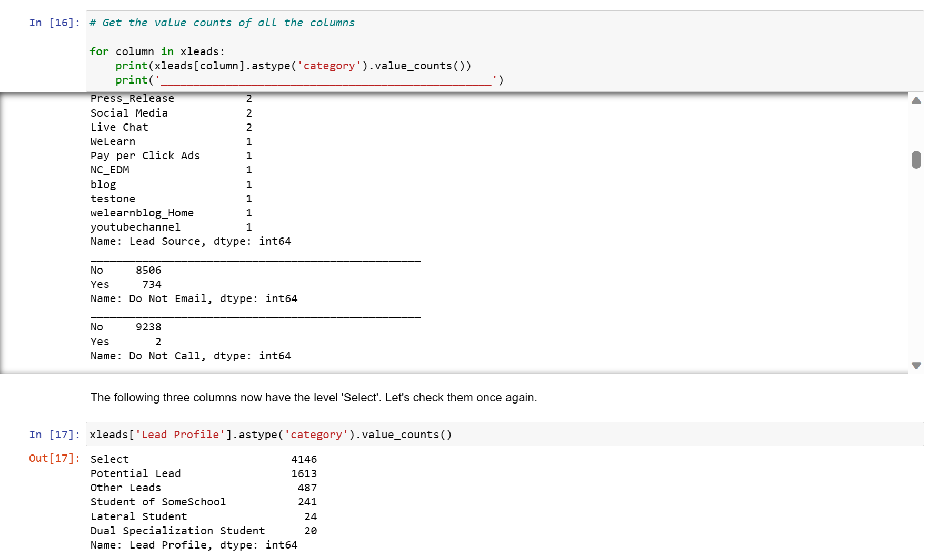

Slide 12
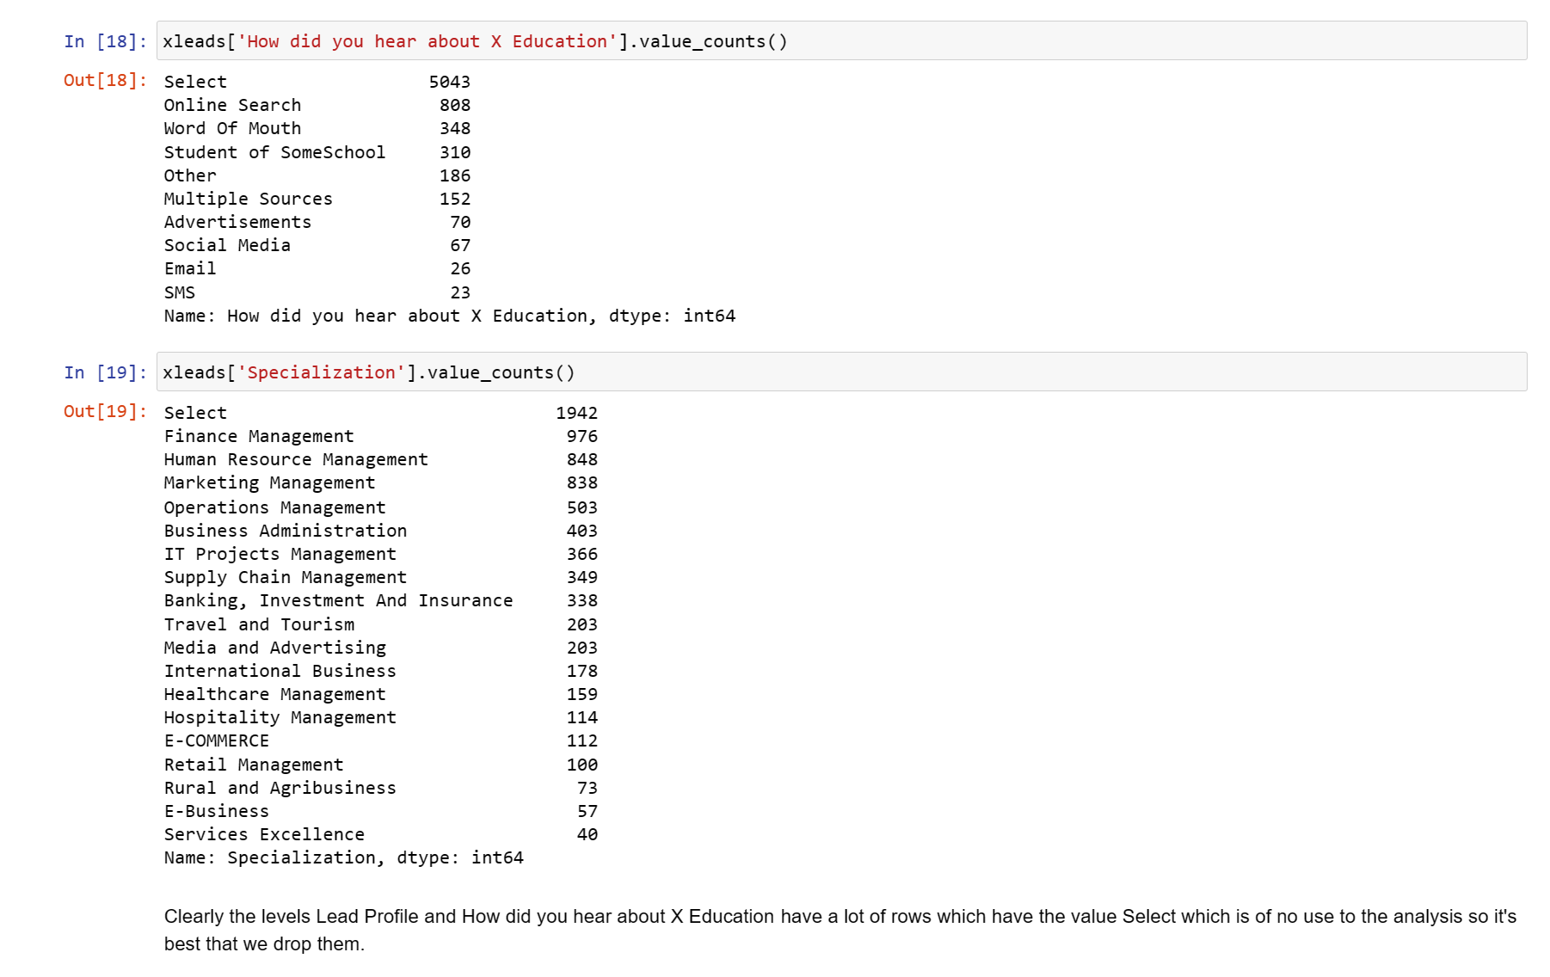

Slide 13
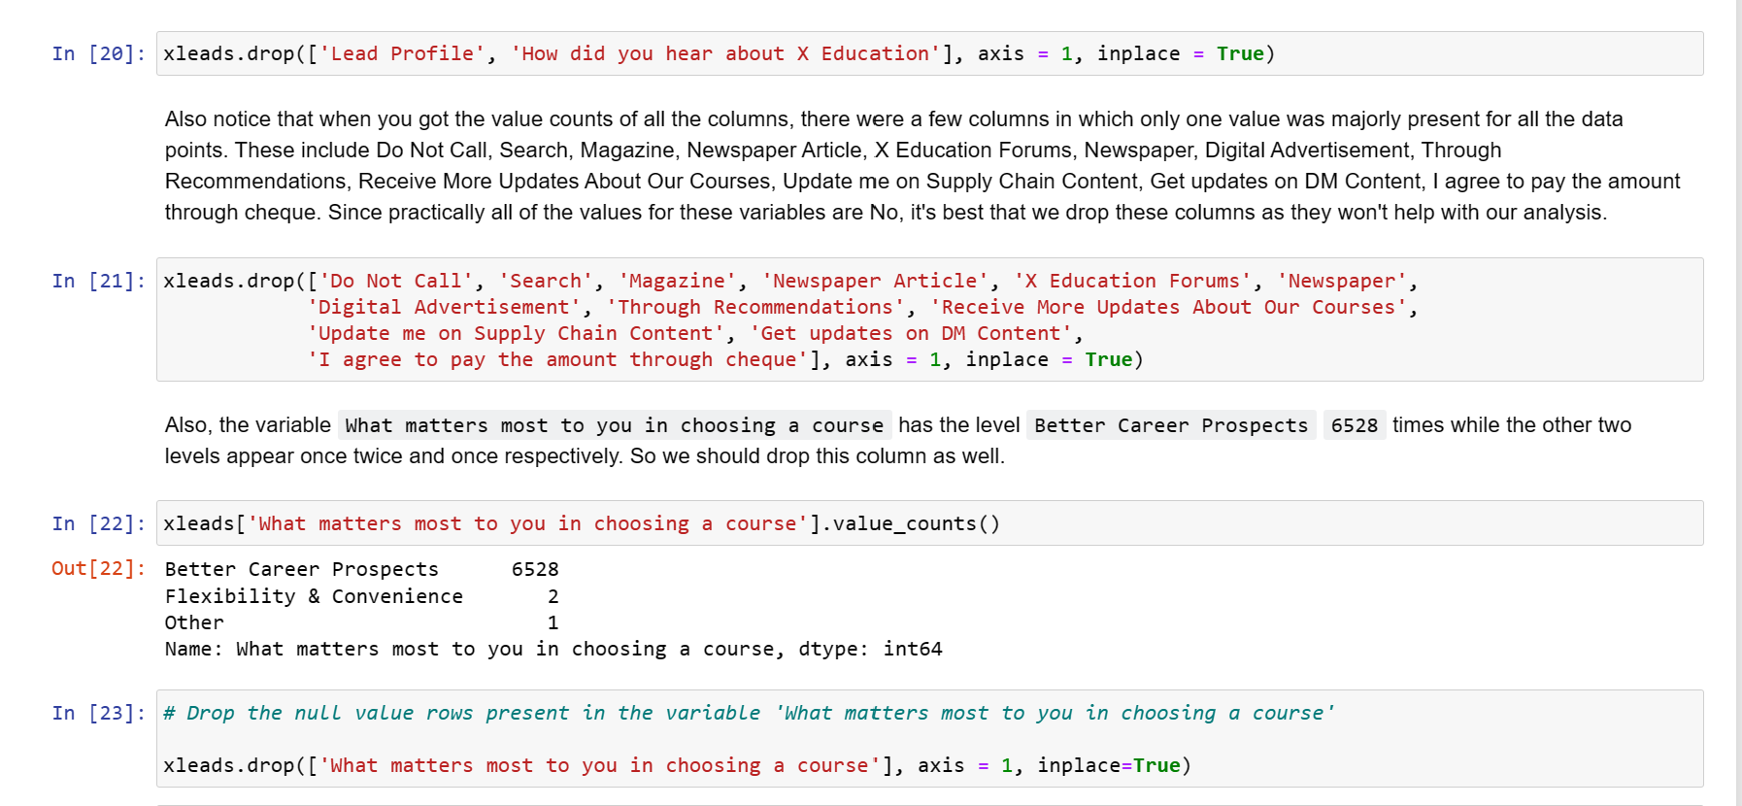

Slide 14
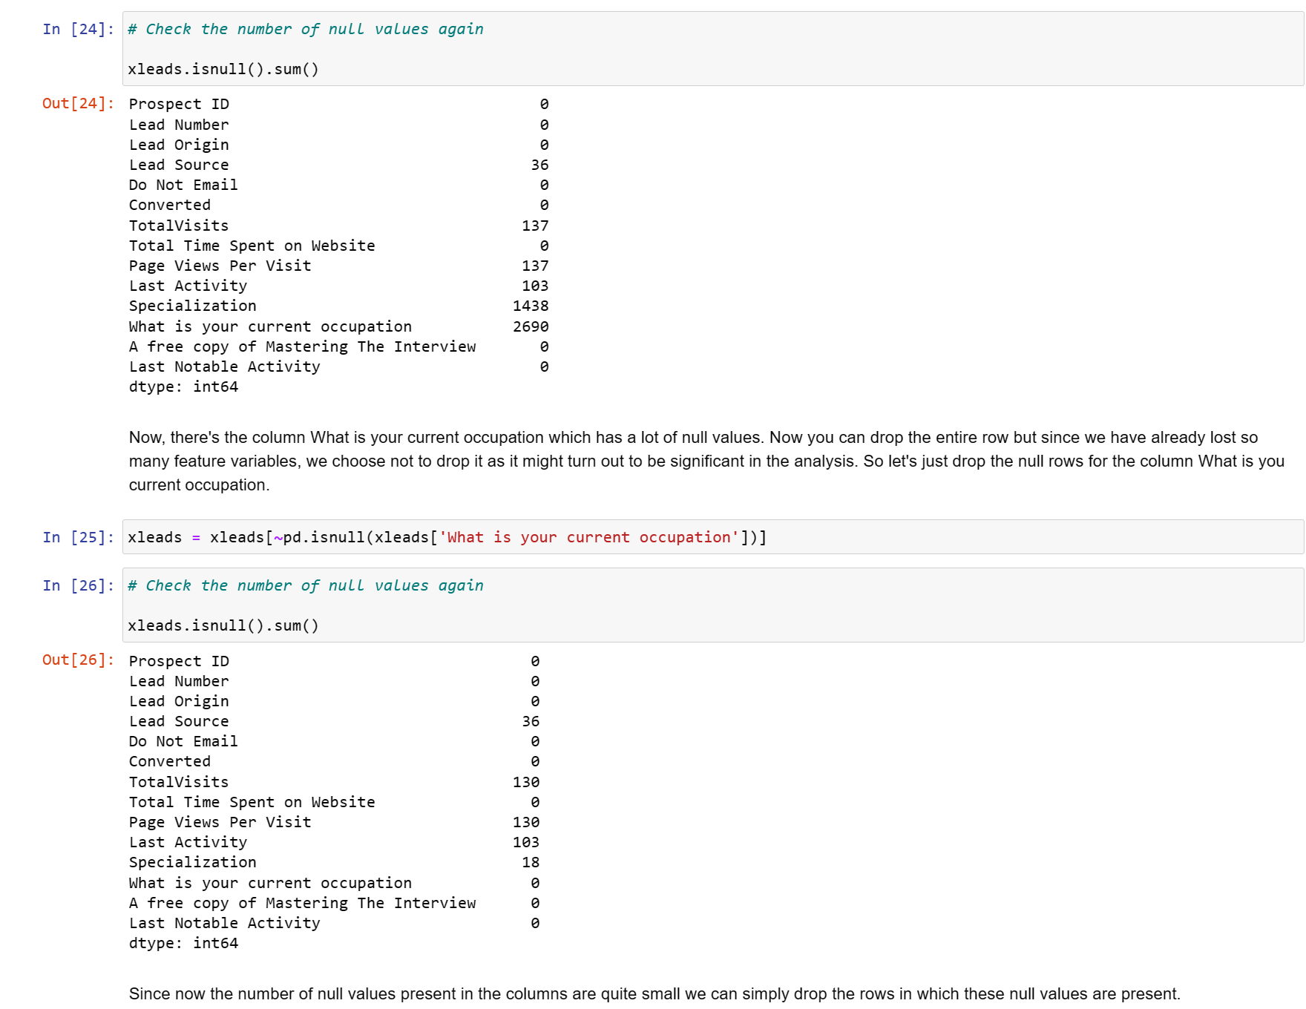

Slide 15
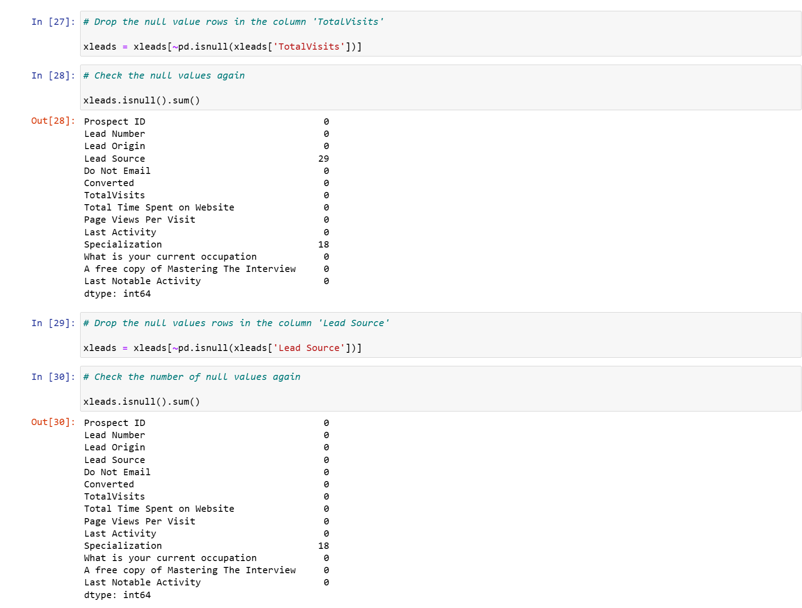

Slide 16
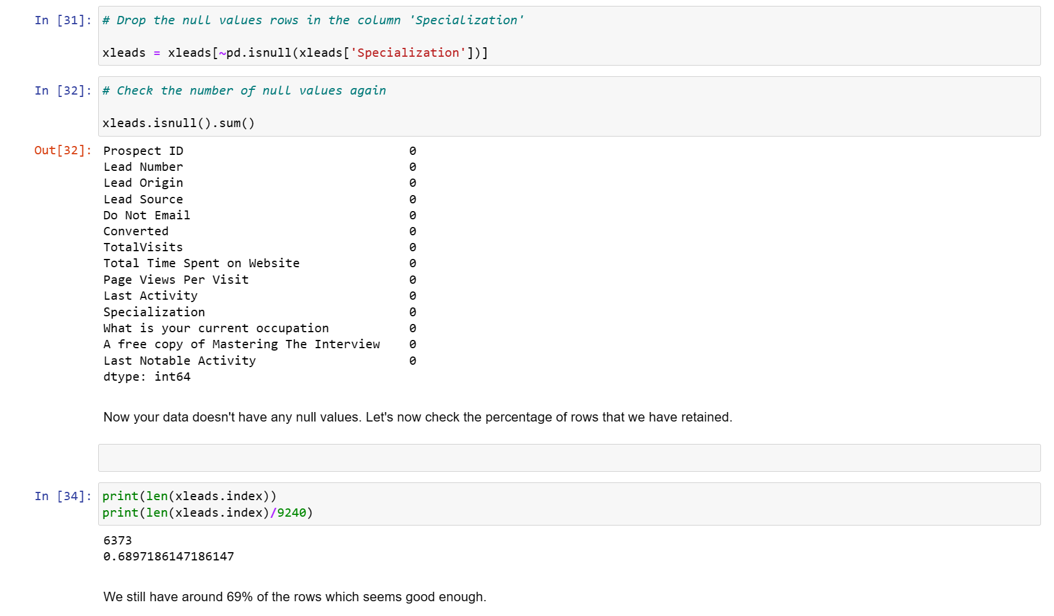

Slide 17
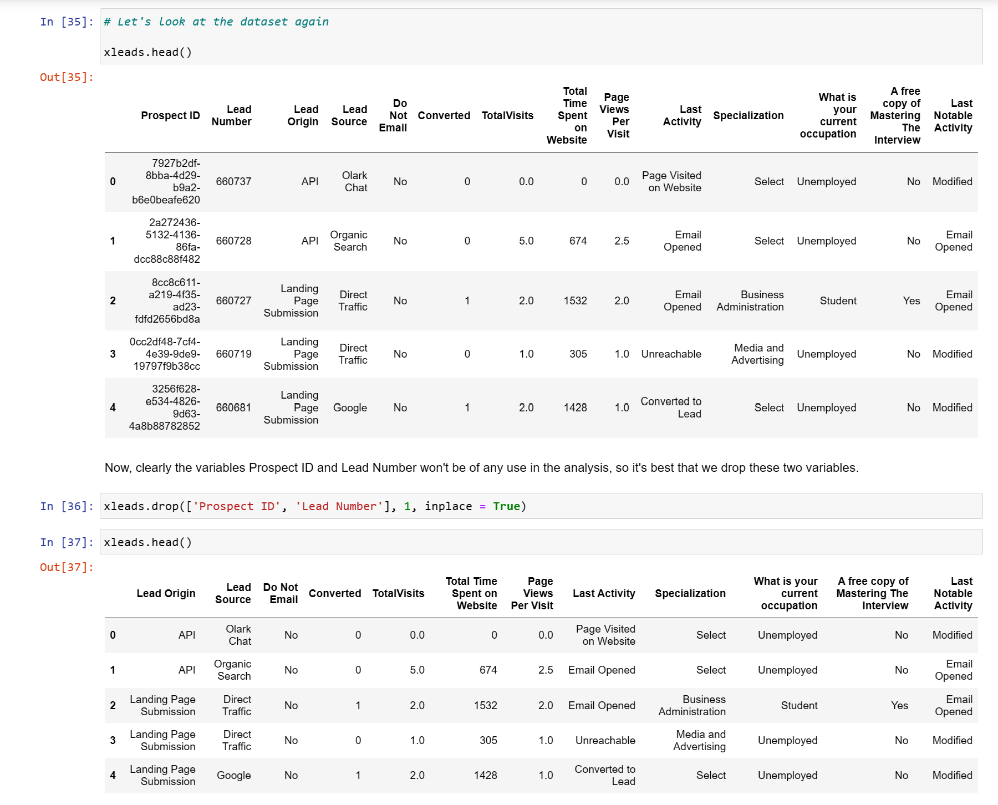

Slide 18
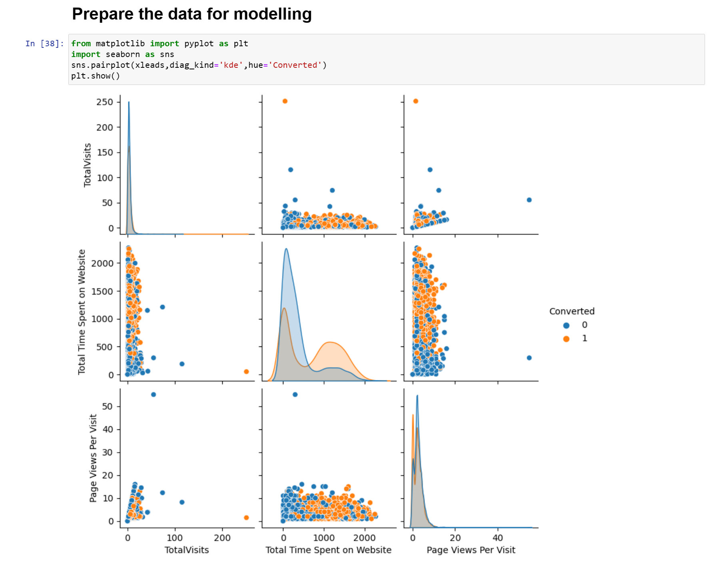

Slide 19
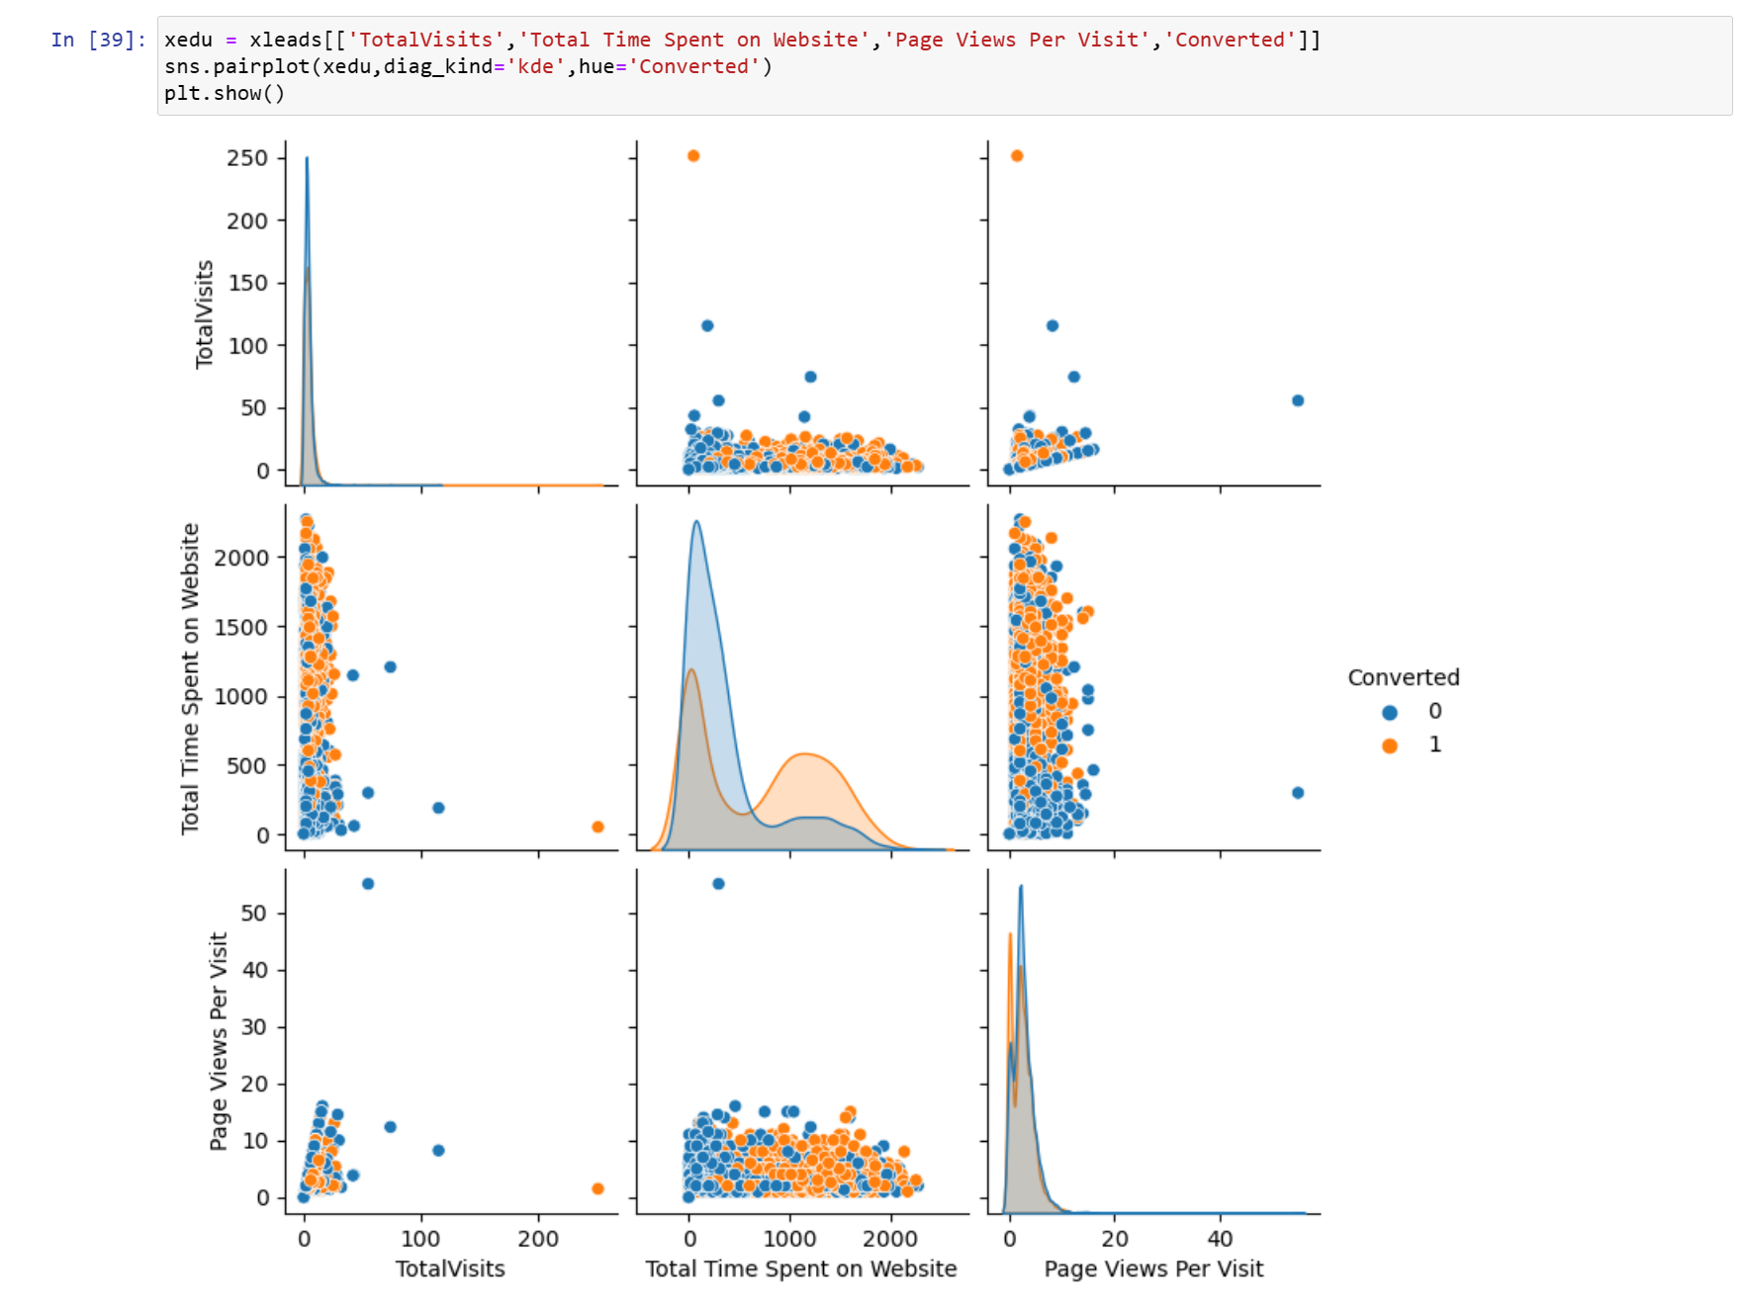

Slide 20
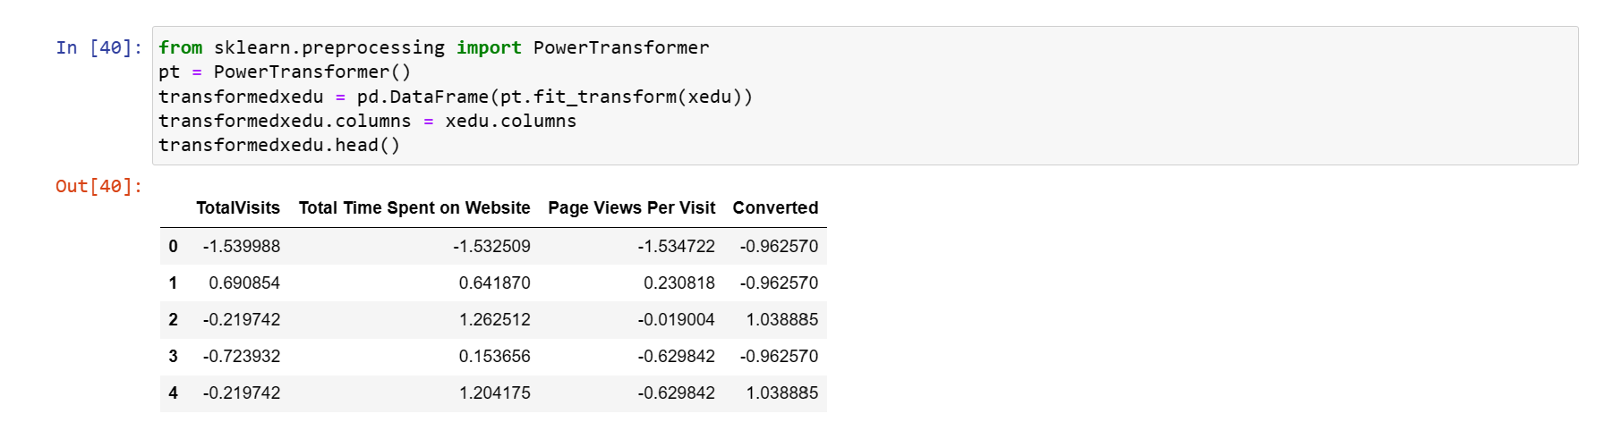

Slide 21
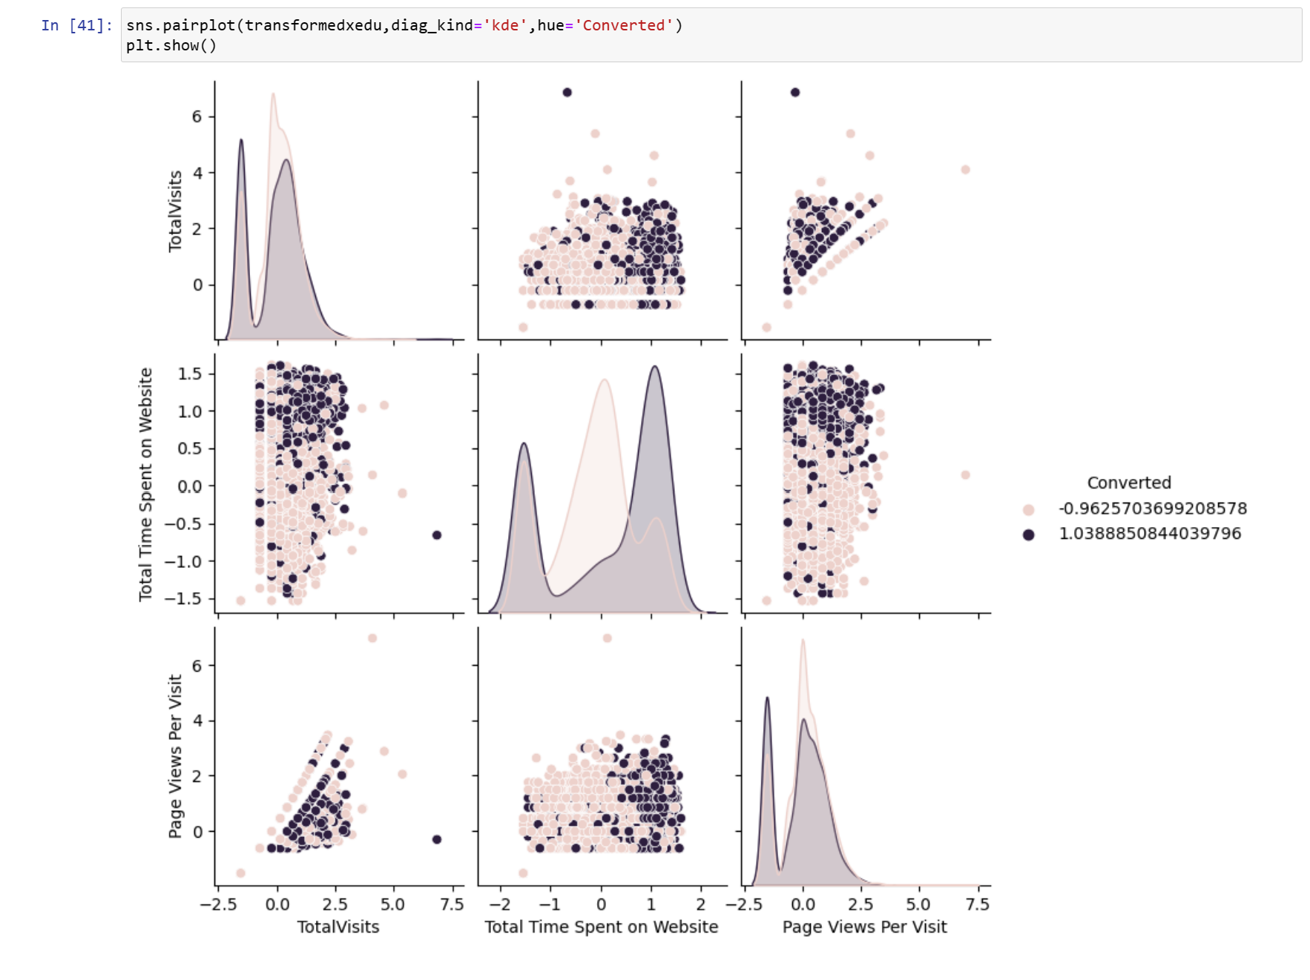

Slide 22
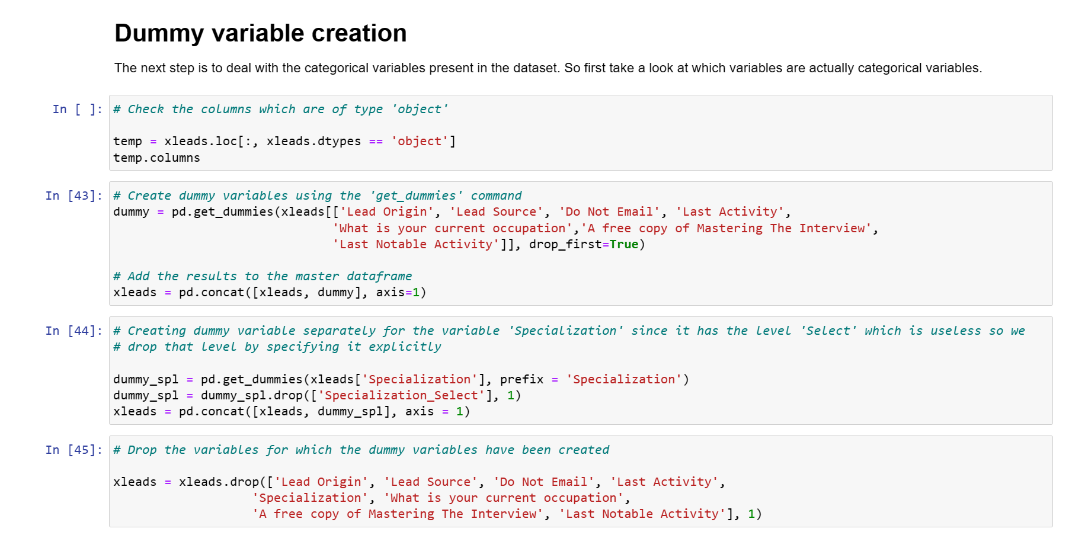

Slide 23
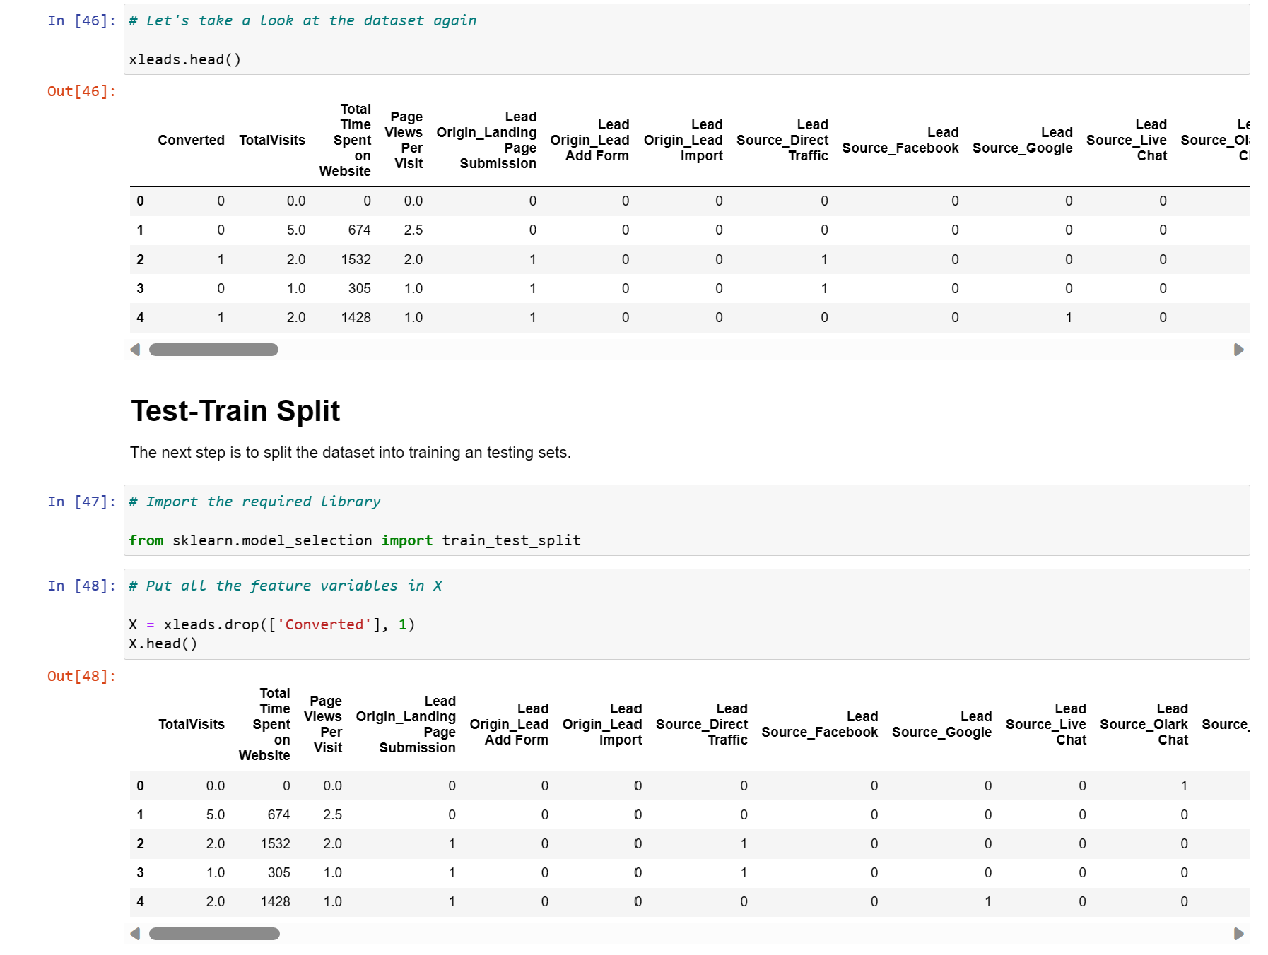

Slide 24
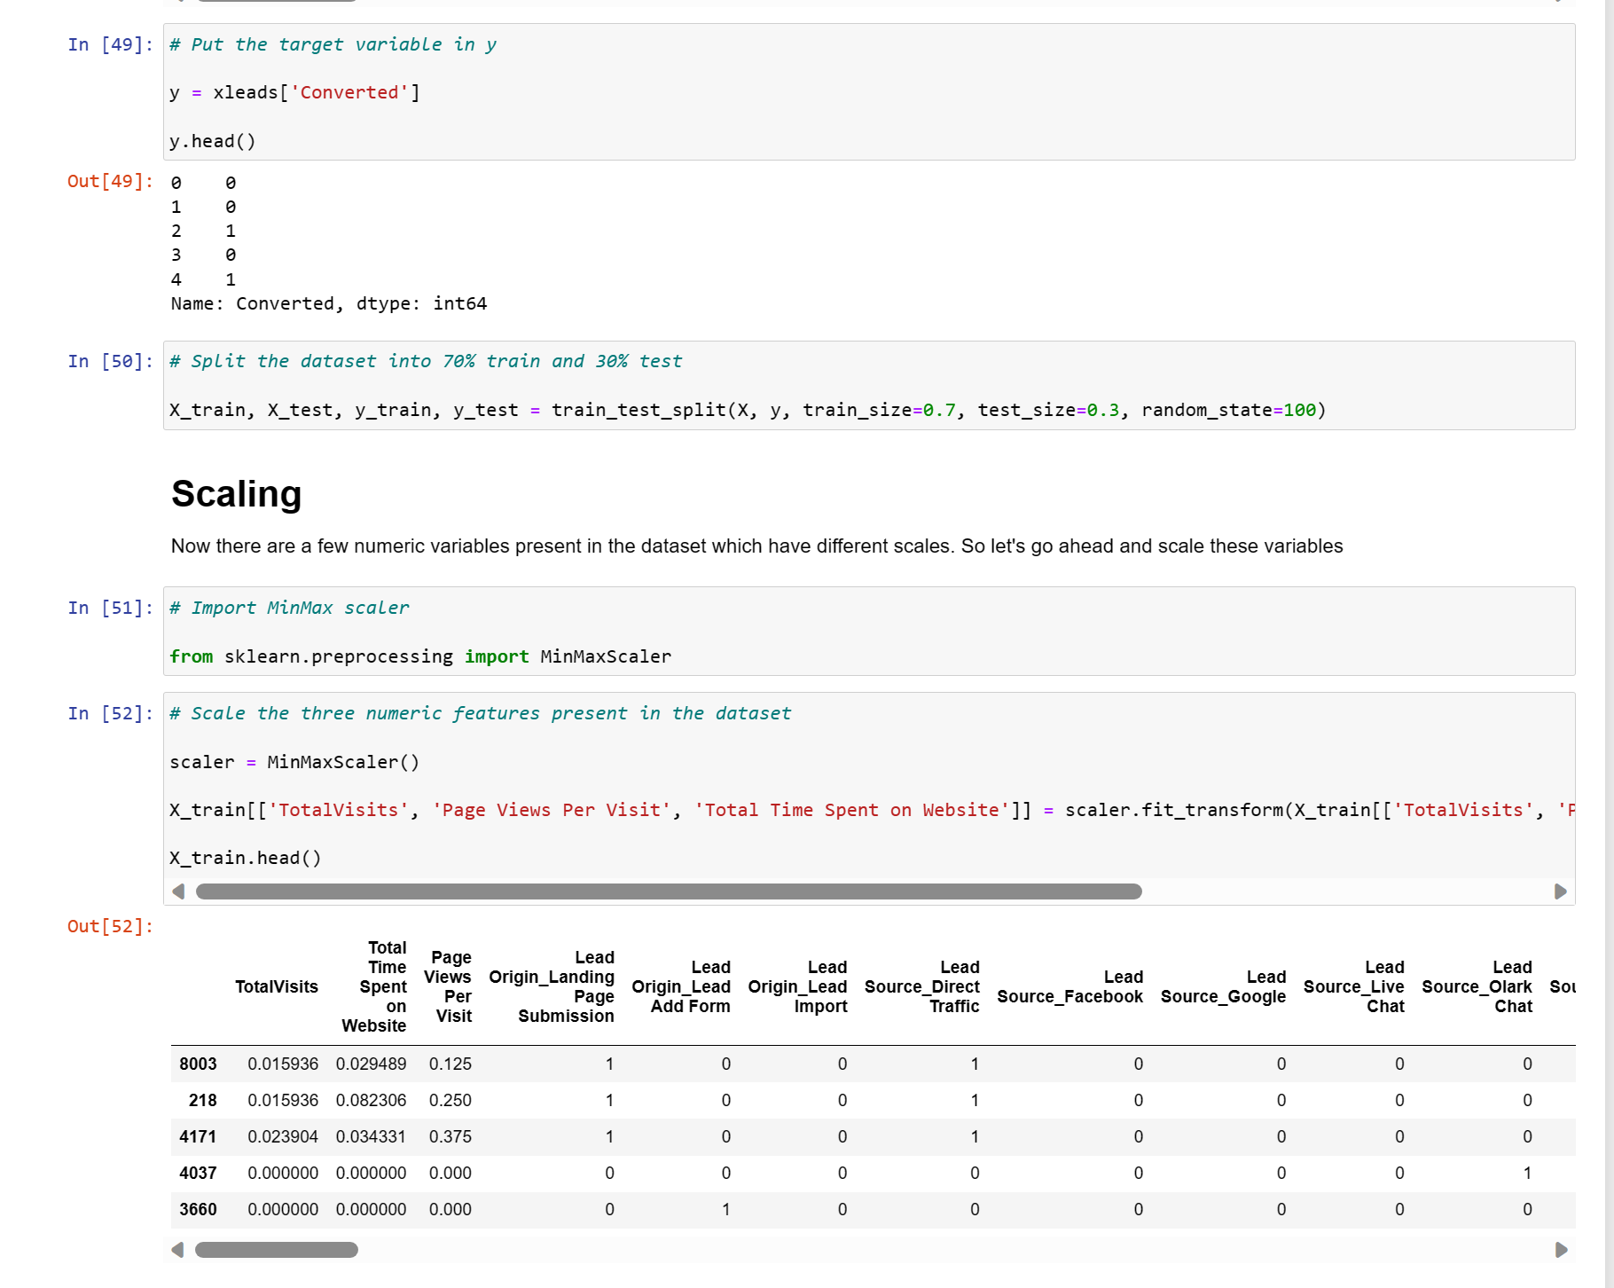

Slide 25
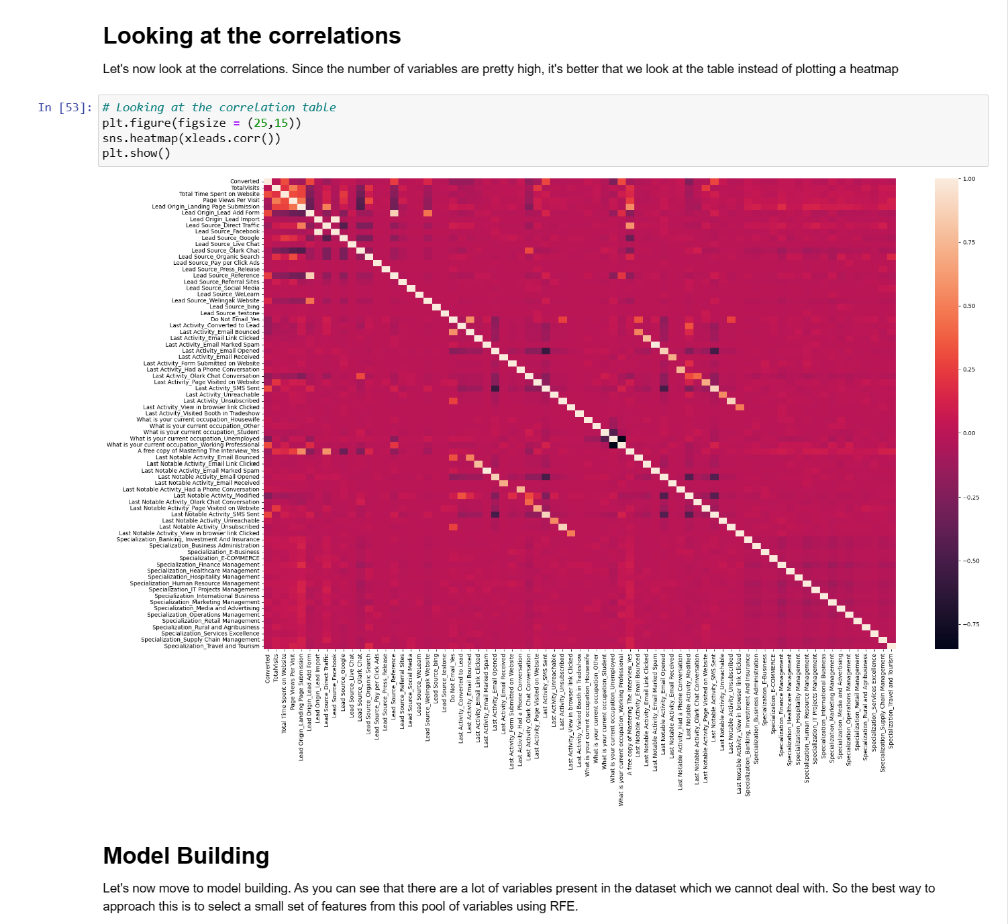

Slide 26
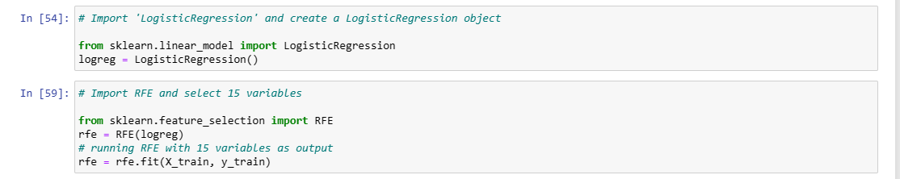
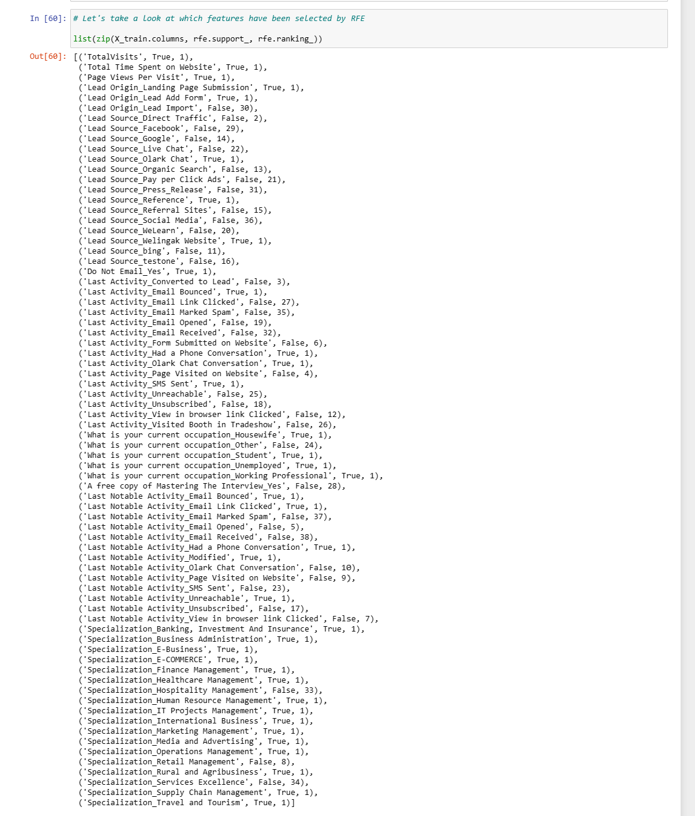

Slide 27
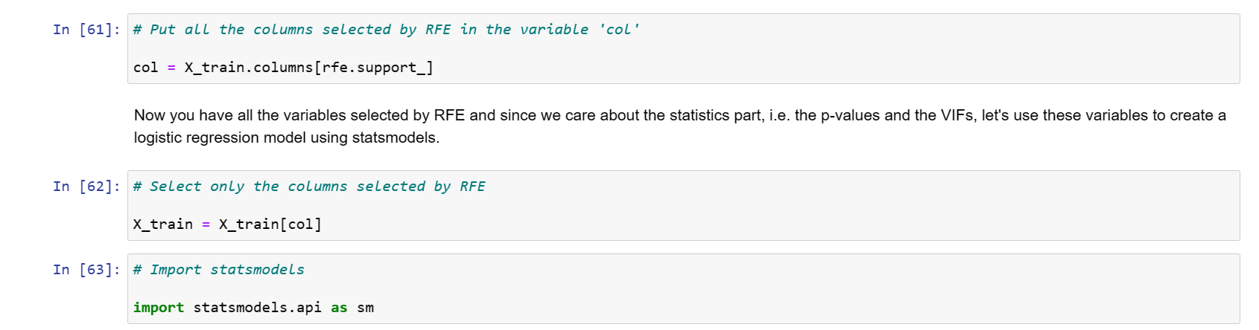
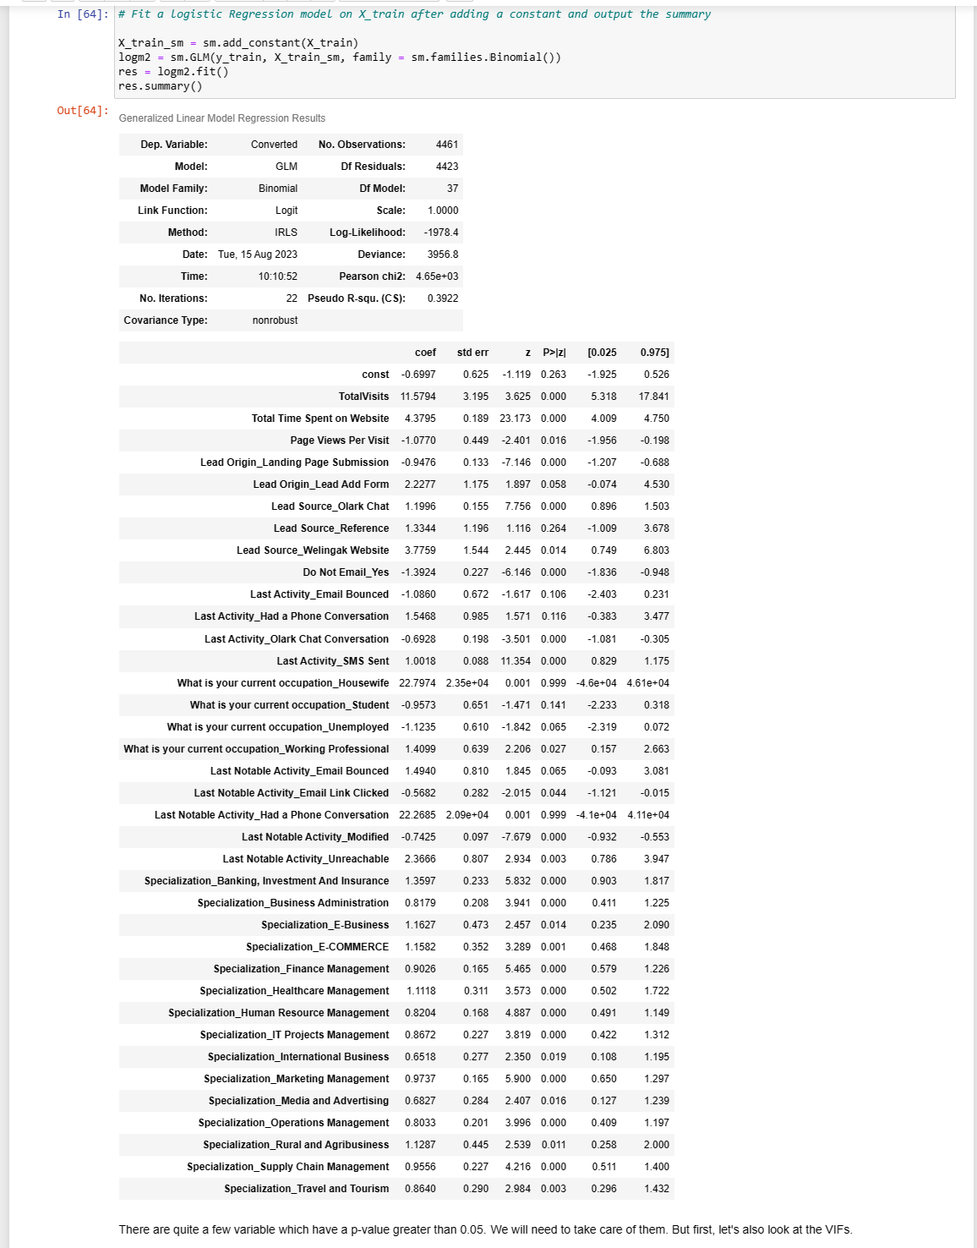

Slide 28
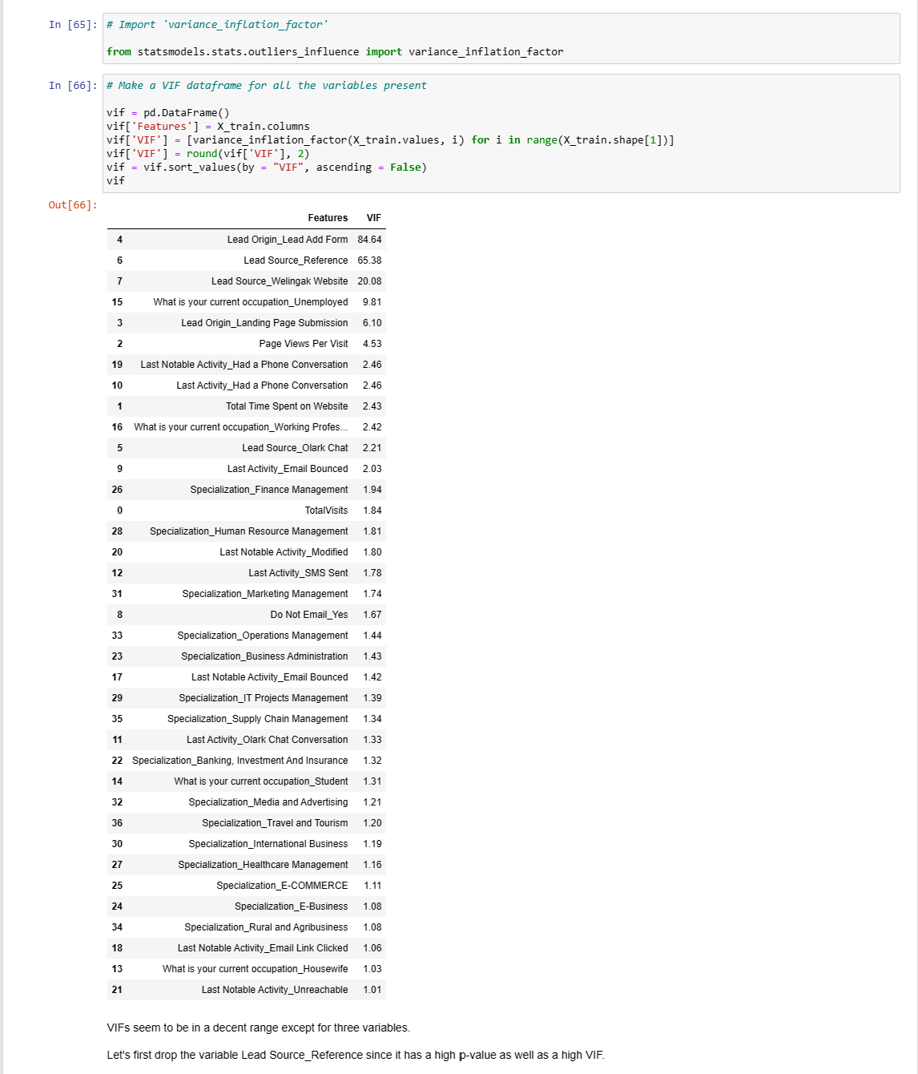

Slide 29
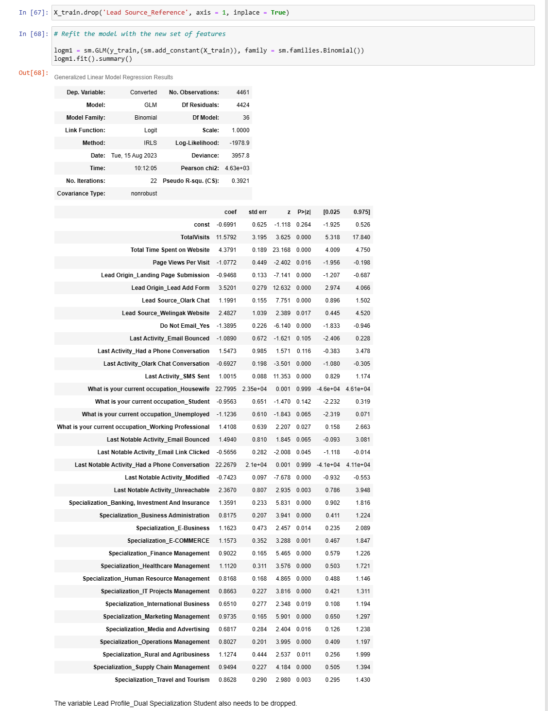

Slide 30
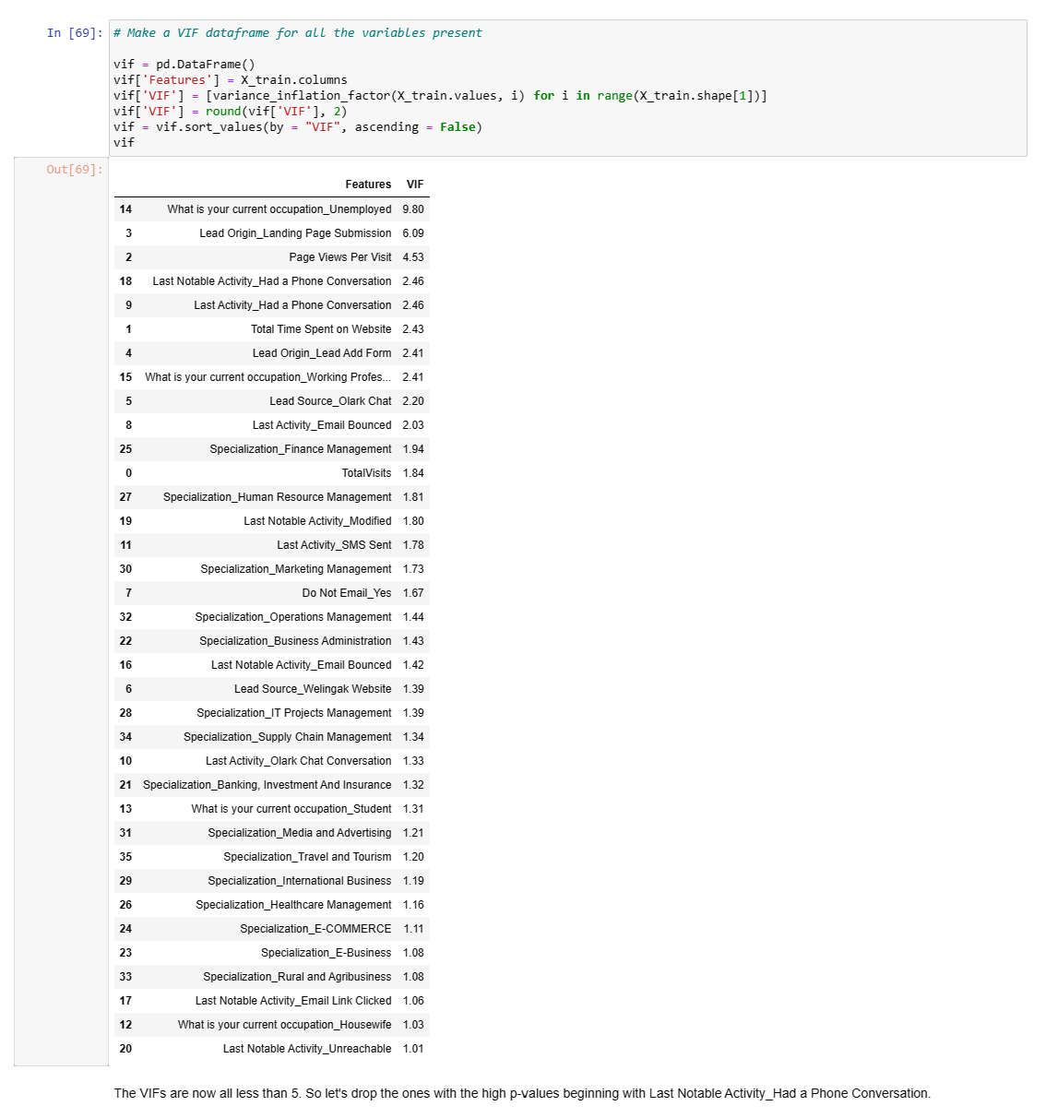

Slide 31
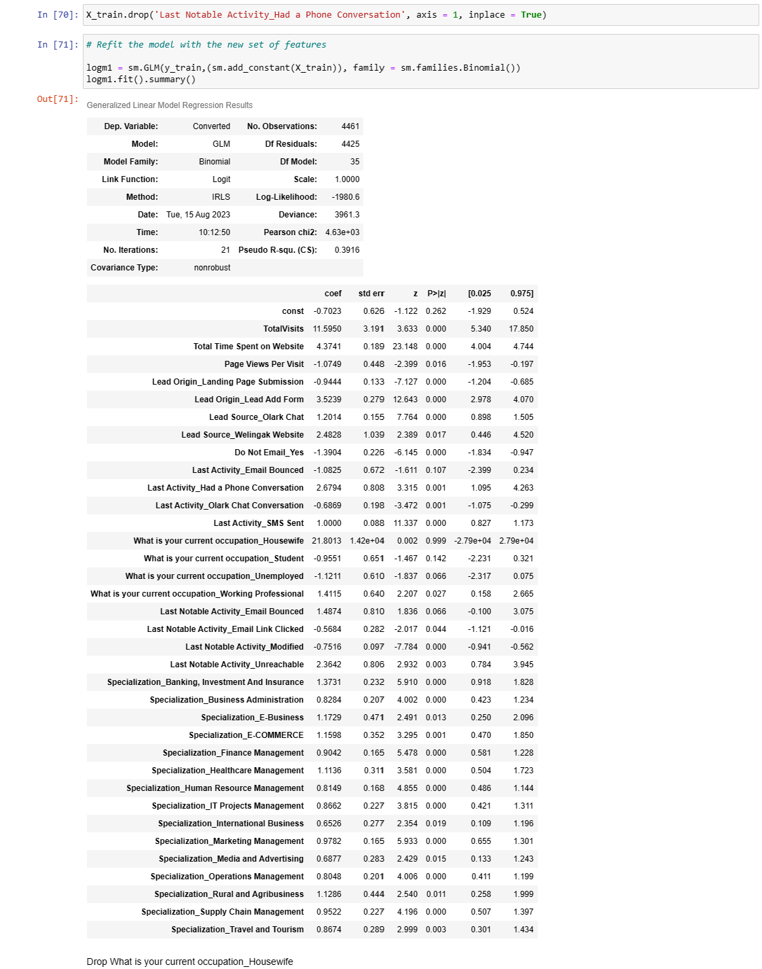

Slide 32
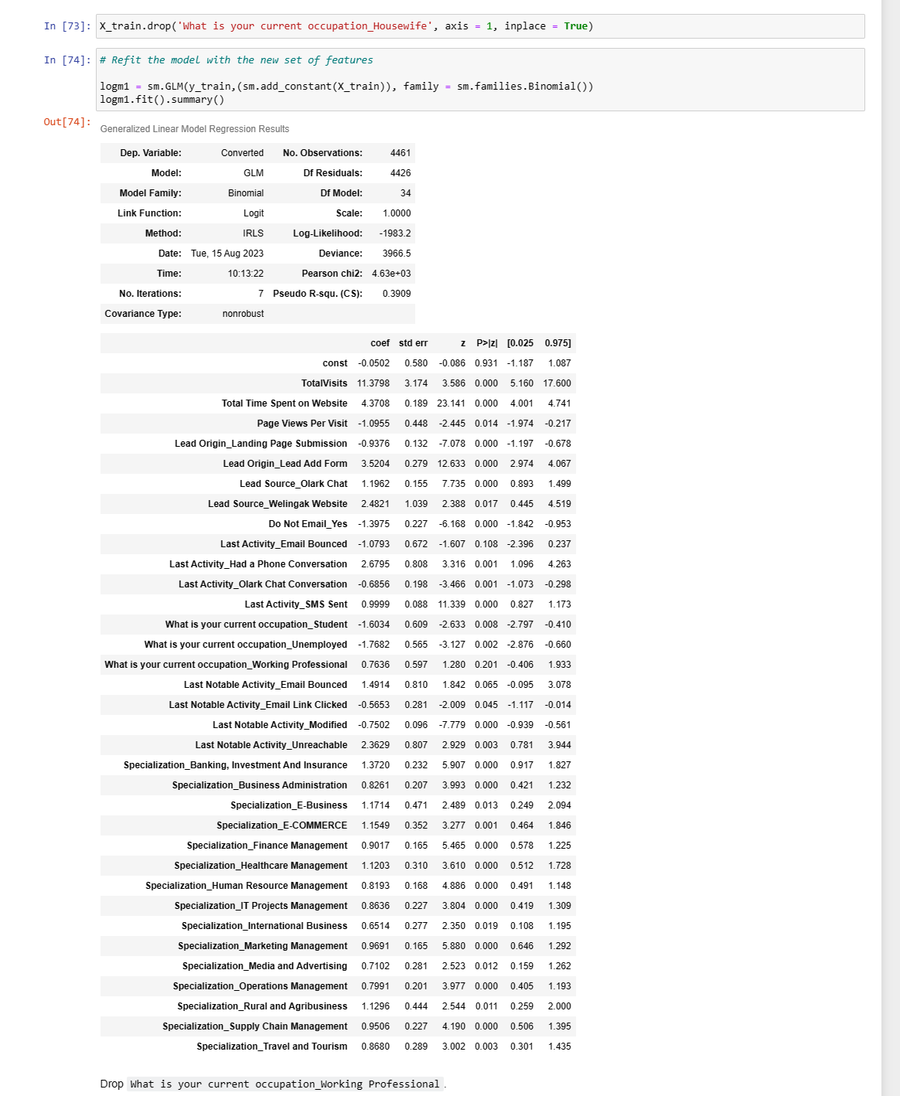

Slide 33
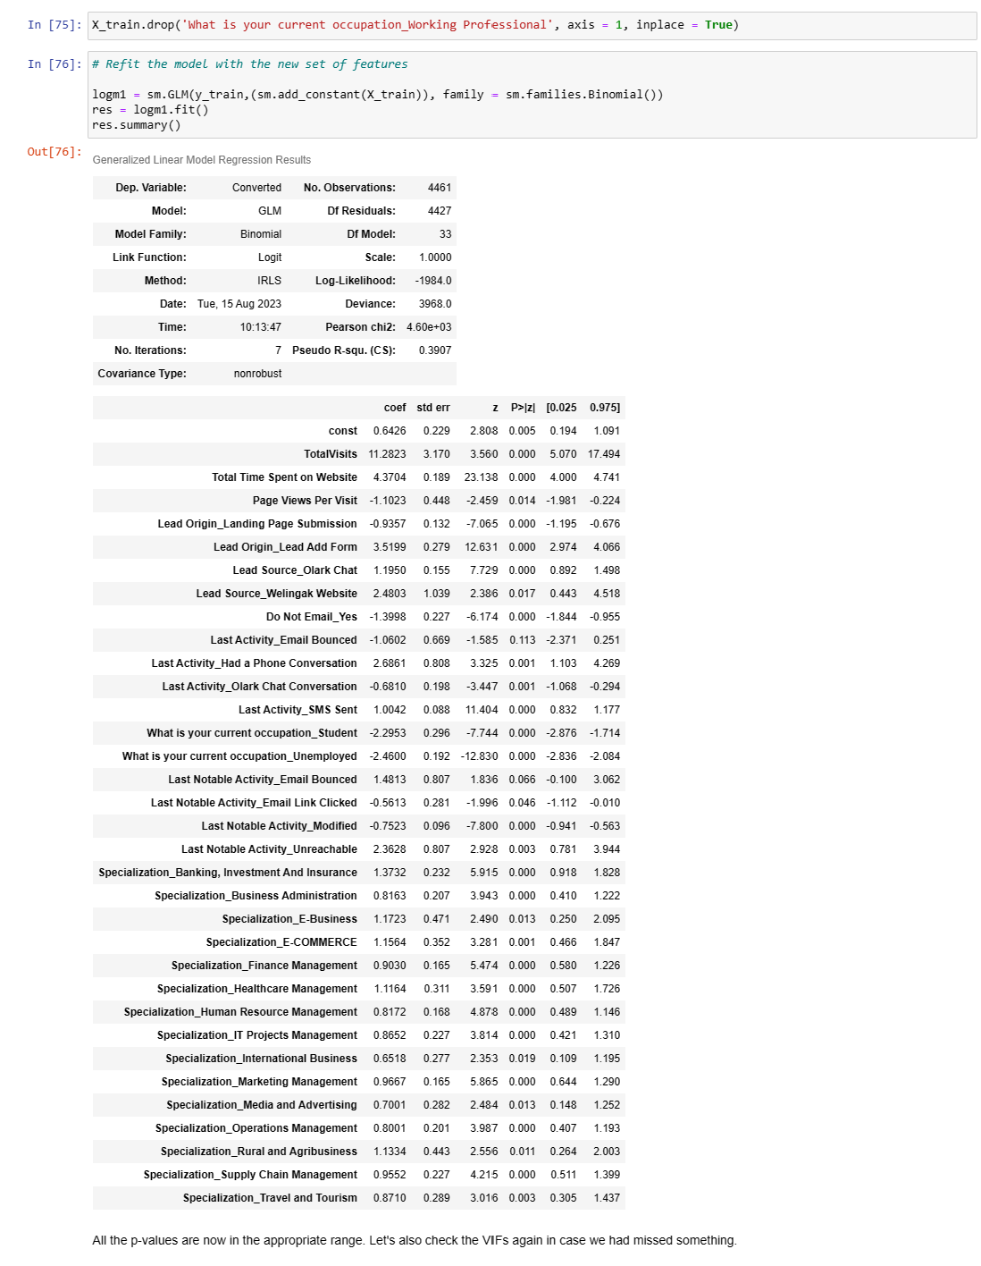

Slide 34
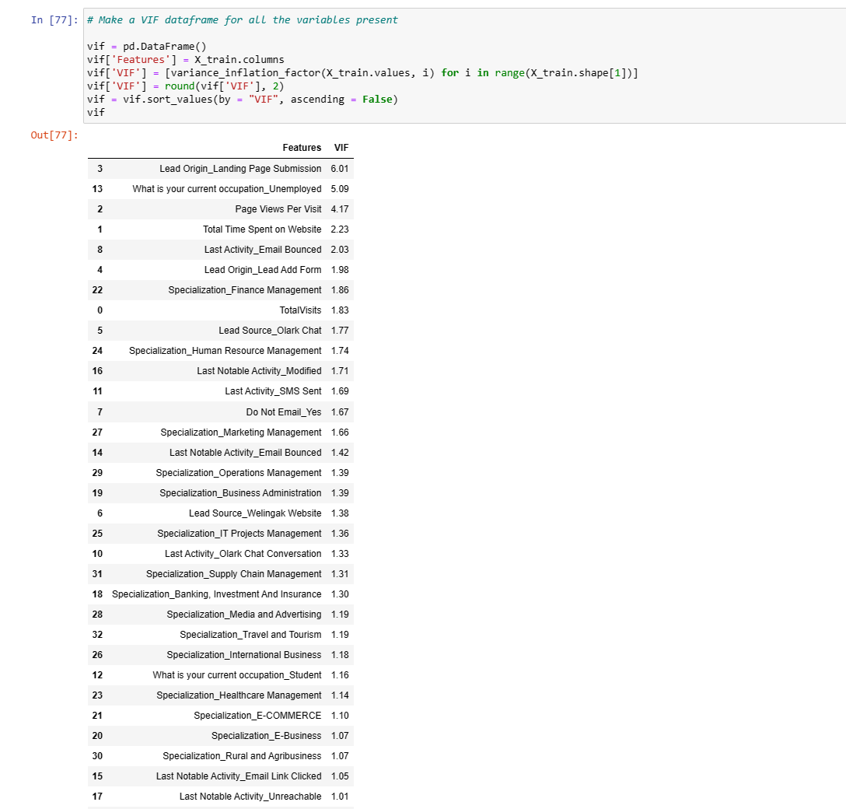

Slide 35
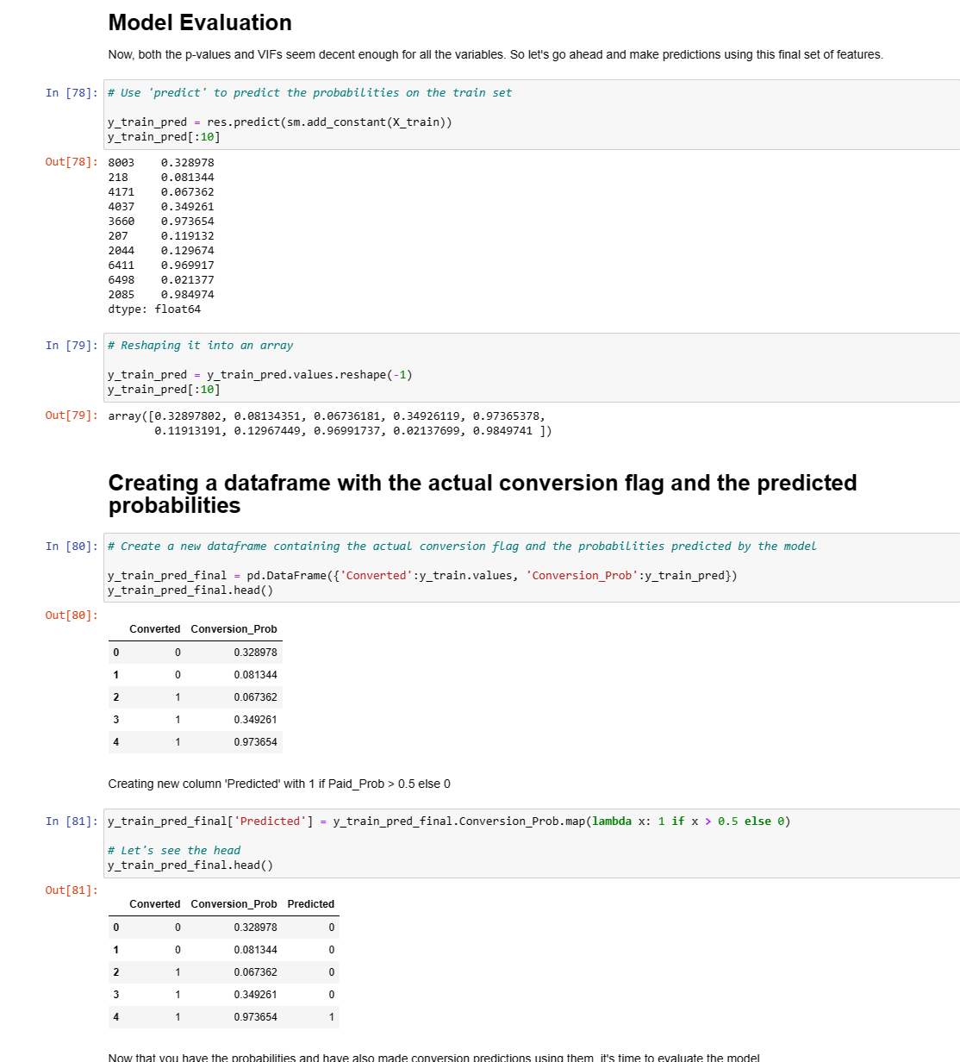

Slide 36
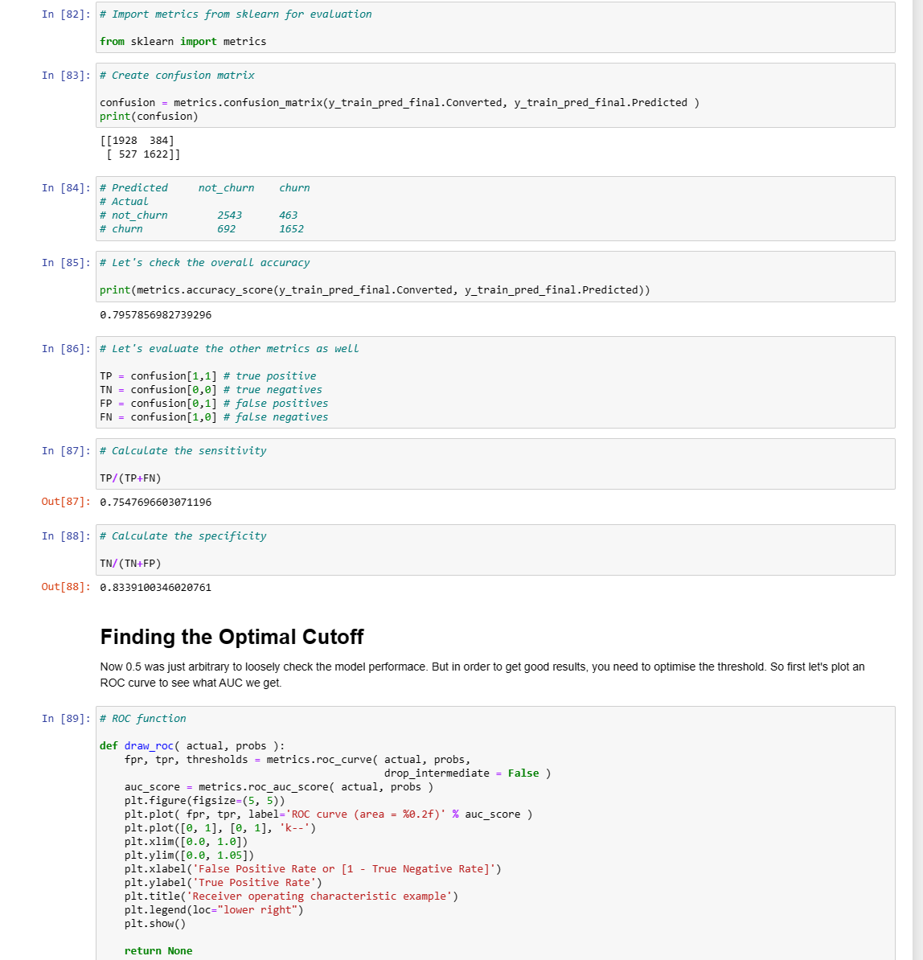

Slide 37
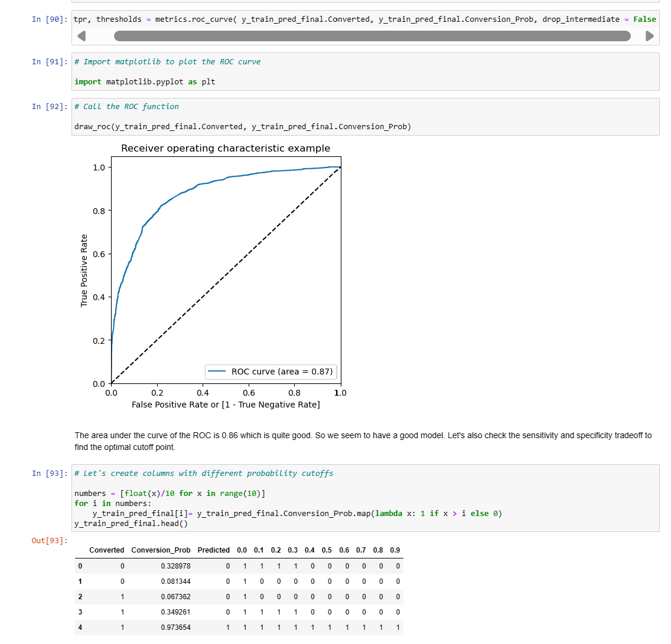

Slide 38
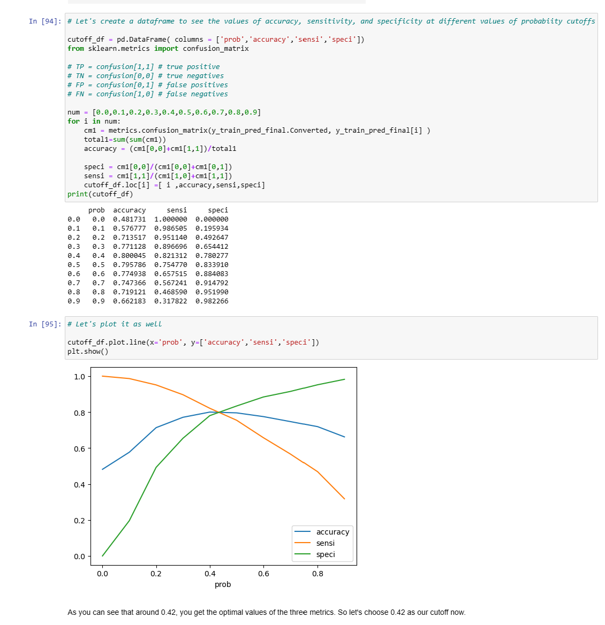

Slide 39
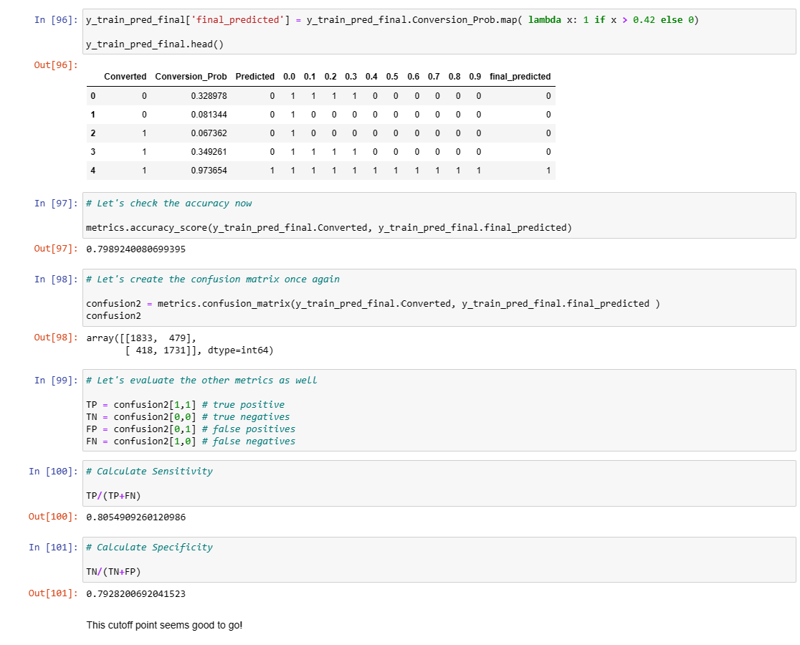

Slide 40
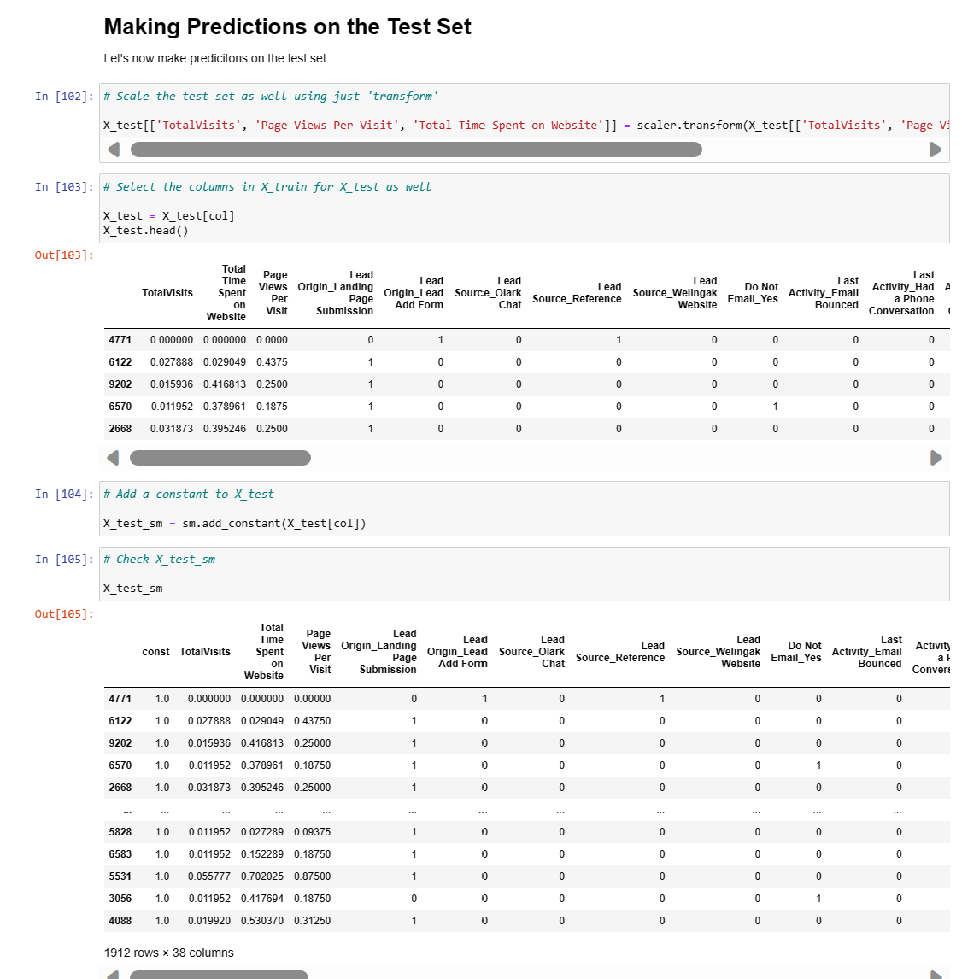

Slide 41
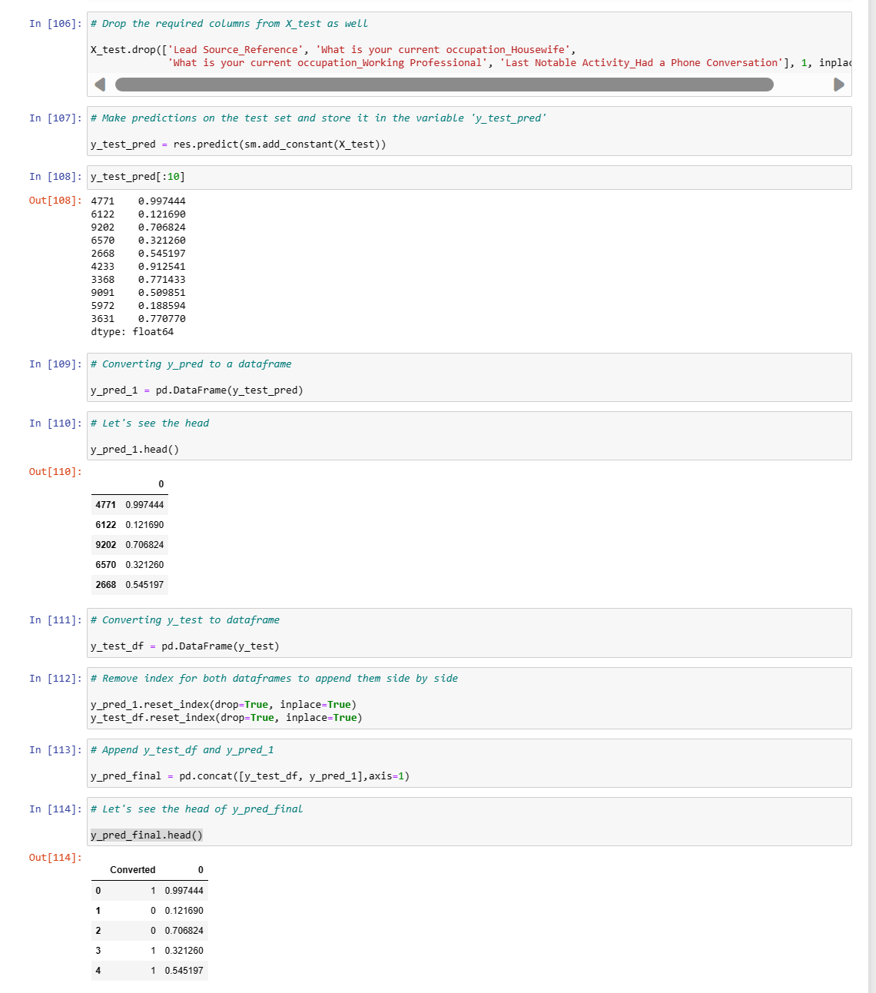

Slide 42
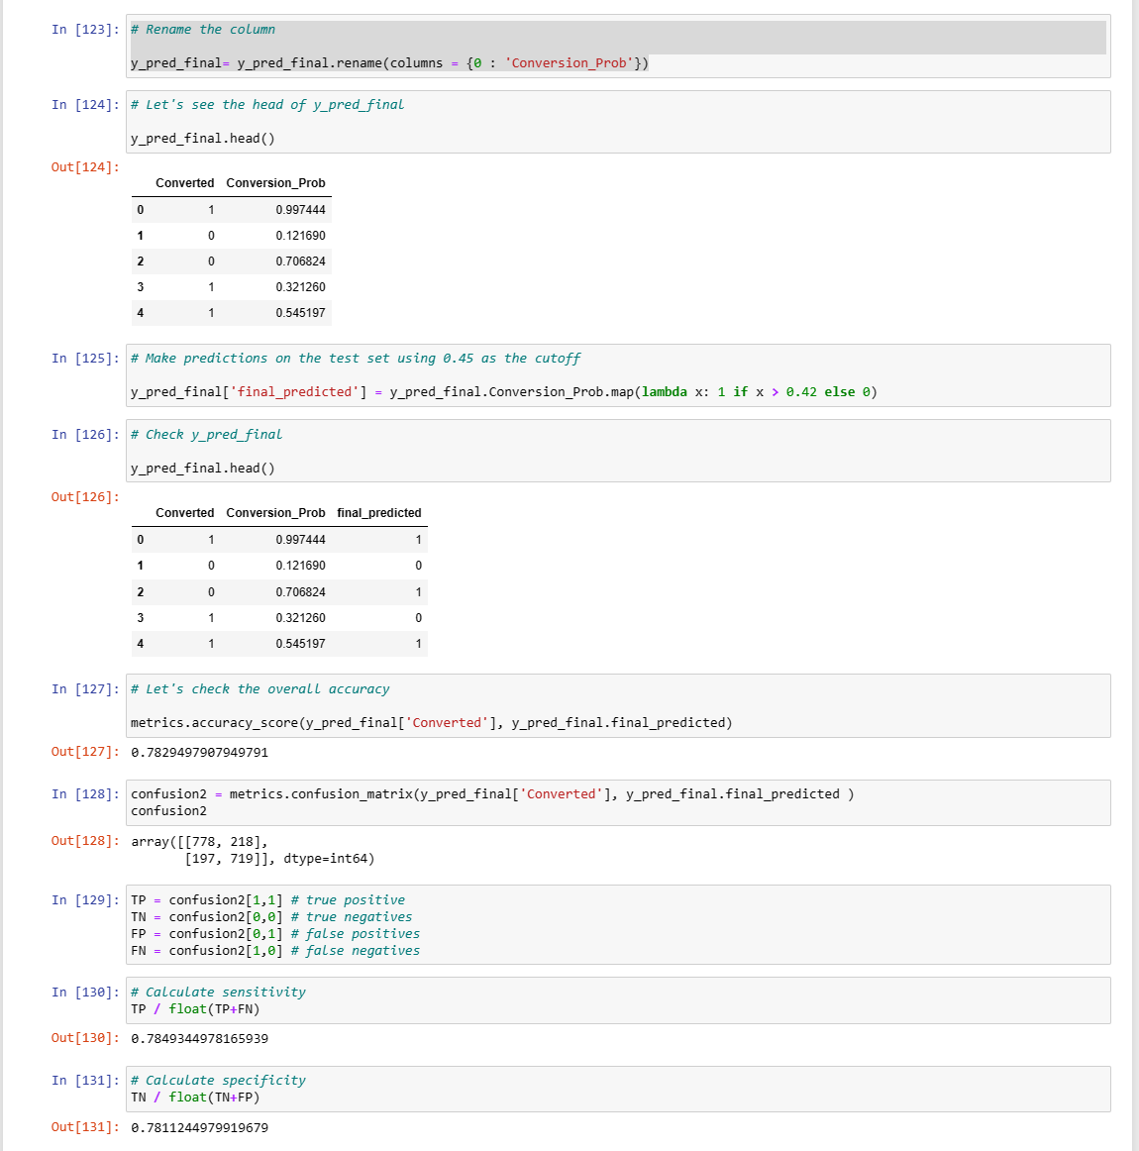

Slide 43
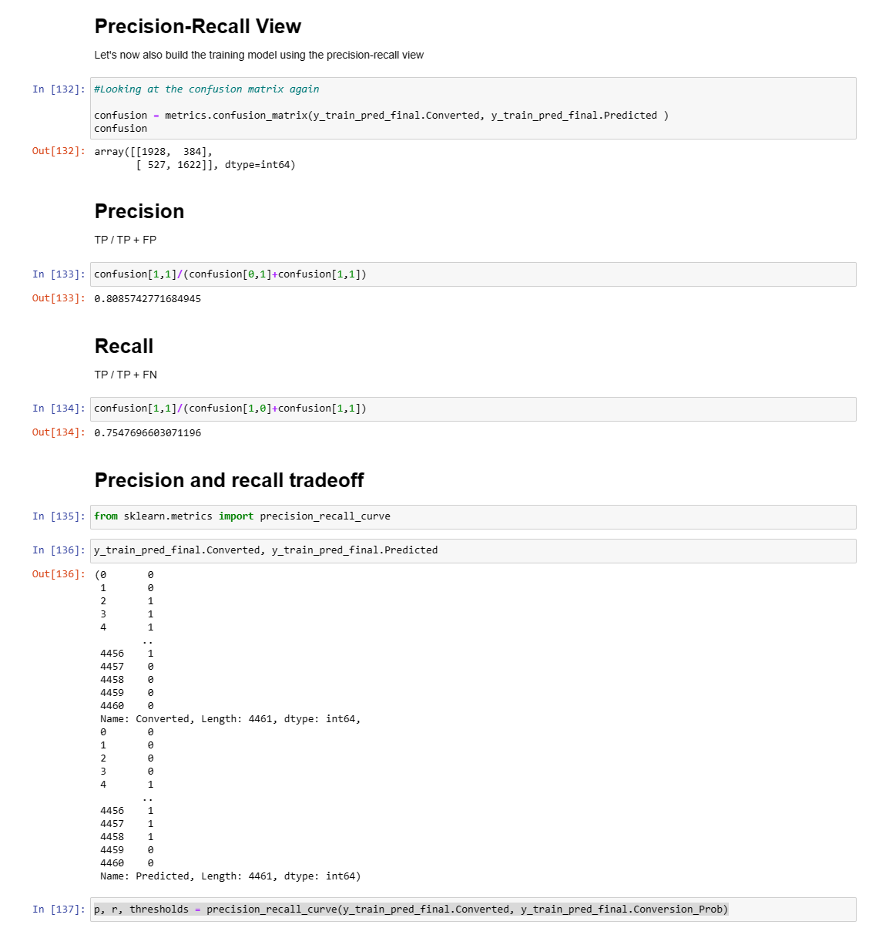

Slide 44
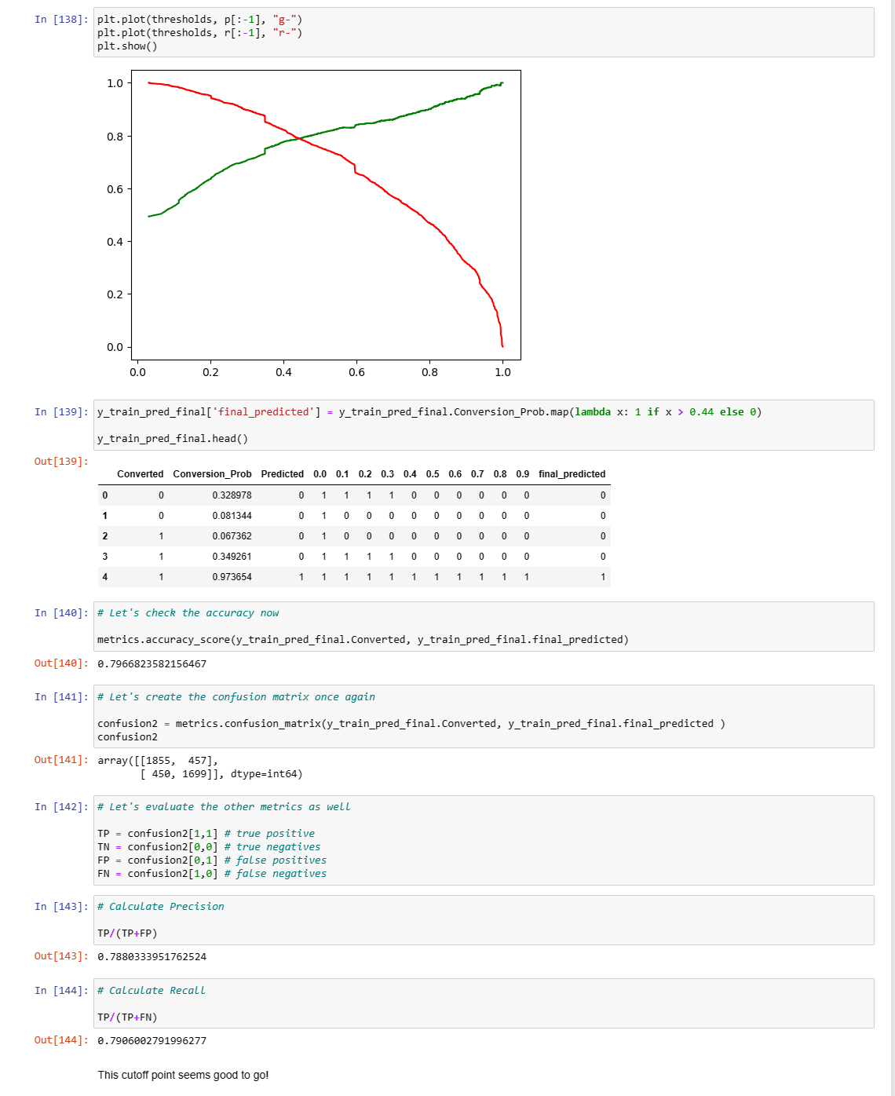

Slide 45
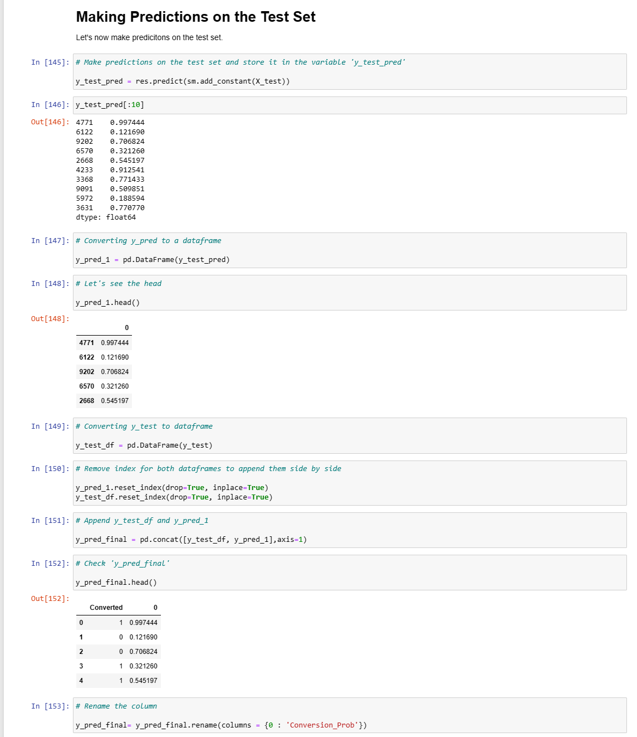

Slide 46
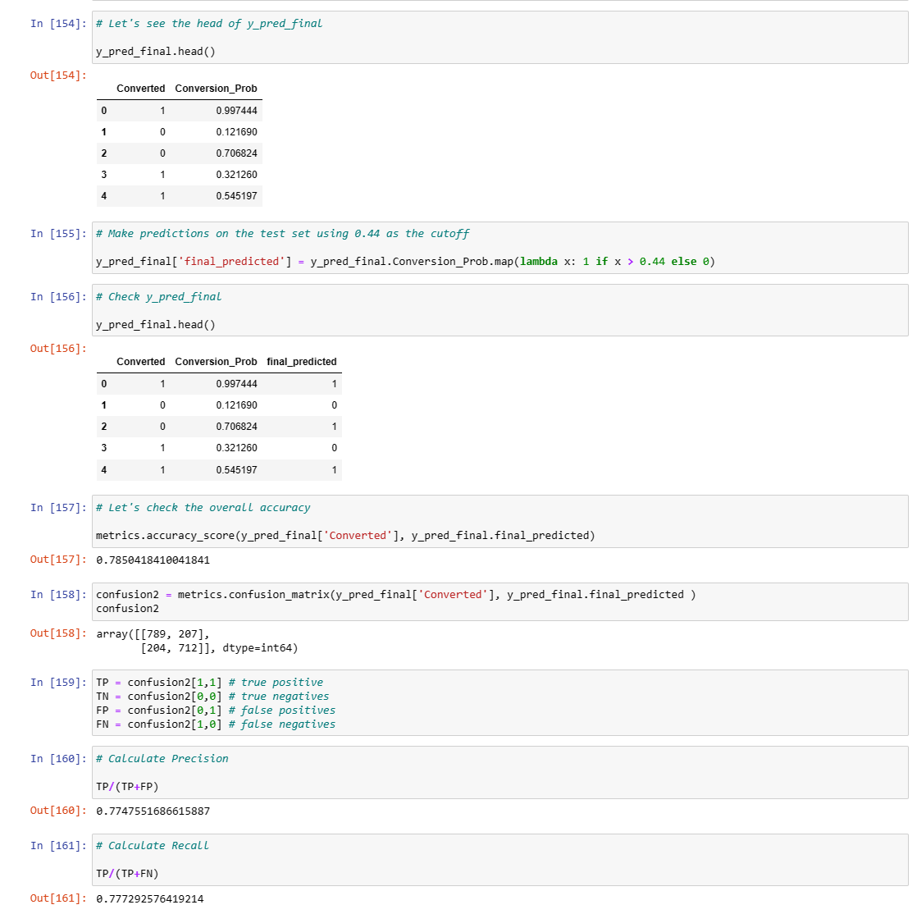

Slide 47
